Slide 1



MEDICATION ABORTION IN EARLY PREGNANCY
PRESENTER NAME HERE
Notes:
UPDATED 10/2024
Data/chart/maps, related speaker notes, and references on slide 7, 8, 9, 10, 29, 36, 37
Speaker notes to reflect current legal landscape on slide 11, 14
Simplify table and add “sublingual” on slide 17
Anticipatory guidance to reflect updated protocol in speaker notes on slide 24
Speaker notes on slide 30 + adding slide 31 for more information on how to get Mife and pharmacy dispensing
Delete slide 35 (VC on SMA)
UPDATED 06/2022
Minor update to slide 14 on 01/2023
02/2023: Updates to slides 9 and 10
06/2023: Updates to slides 8, 9, 10, added slide 24
This presentation was revised by RHAP’s Clinical Committee and Chelsea Faso, MD.

Slide 2

DISCLOSURES
Participants must attend 100% of this workshop.
Participants must complete the evaluation survey at the beginning and end of the workshop
No relevant financial relationships to disclose with ineligible companies.
Notes:
Note to RHAP Staff: Please UPDATE if any presenters DO disclose a relevant financial relationship. Examples of how to word disclosures can be found in Identification, Mitigation, and Disclosure Toolkit (CME/CNE Materials folder)
Note: if this workshop is not being facilitated through RHAP, there is no CE credit or contact hours available

Slide 3

CE PRE-TEST.
Please complete this pre-test on your phone or computer in order to receive CE hours for participation in this workshop. You can access the pre-test at:
https://www.surveymonkey.com/r/MAB101Pre
Notes:
Before we begin, if you haven’t already please complete this pre-test on your phone in order to get CE contact hours for this workshop. You can access the pre-test at…
https://www.surveymonkey.com/r/MAB101Pre
Note: if this workshop is not being facilitated through RHAP, there is no CE credit or contact hours available

Slide 4
LEARNING OBJECTIVES.
Describe the steps to provide two medication abortion care regimens: 1) mifepristone and misoprostol, and 2) misoprostol alone
Apply knowledge on medication abortion regimens to answer questions or provide follow-up care, including for people who may self-manage / self-source their abortion.
Access resources to solve logistical and administrative barriers to providing medication abortion in primary care.

Slide 5

TERMINOLOGY
The human right to maintain personal bodily autonomy, have children, not have children, and parent the children we have in safe and sustainable communities.
- Sister Song
Reproductive Justice
Notes:
We’d like to begin this session by first grounding ourselves and our work as clinicians in an understanding of reproductive justice, reproductive autonomy, and how these principles relate to providing abortion care.
As we’ve seen, the legal right to abortion is not enough to ensure everyone has safe, dignified, and equitable access to abortion care. What good is a right if not all communities can access the services that right is supposed to provide? Reproductive justice links reproductive rights with the social, political, and economic inequalities that affect a person’s / community’s ability to access reproductive health care services, to exercise their ”right to choose” when and whether to have kids, and to parent their kids in safe, dignified environments. It asserts people’s rights to “express sexuality without oppression” and to “control their own body and self-expression, free from any form of sexual or reproductive oppression.”
Reproductive justice was coined in 1994, by a group of black female activists that grew frustrated with the limitations of the pro choice movement – reflecting on the minimal choices Black women and other people of color experienced. They knew that the world needed a framework for understanding the lived and intersectional experiences of women of color and low-income women: one that centered on bodily autonomy and improving the policies and systems for people to exercise decision-making power over their bodies and reproductive lives.
Examples:
If someone is working multiple jobs to make ends meet, how can they afford to take time off to go to an abortion clinic? How can they afford to take time off to travel 100 miles, out of state, and wait for a mandatory 24 hour or 48 hour waiting period? How do you arrange childcare while doing all of that too? How do you pay for your abortion when you are on Medicaid, which will not cover abortion care in most instances and most states due to the Hyde Amendment -- which disproportionately affects people of color and low-income people?
“Reproductive justice can only be achieved when all [people] have the complete economic, social, and political power and resources to make healthy decisions about our bodies, our families, and our communities in all areas of our lives.”
Optional Videos to Share with Audience (from 2018)
What is Reproductive Justice? (1:53) https://www.youtube.com/watch?v=I4mwQhKLBiM
The History of Reproductive Justice (2:08) https://www.youtube.com/watch?v=ihwvHHInrlU
What is Reproductive Justice, New Orleans Abortion Fund (3:27): https://www.youtube.com/watch?v=li8a-dC3YbI
References:
https://blackrj.org/our-issues/reproductive-justice/
https://www.sistersong.net/reproductive-justice
https://www1.nyc.gov/site/doh/health/health-topics/sexual-reproductive-justice-nyc.page
https://www.law.berkeley.edu/php-programs/courses/fileDL.php?fID=4051

Slide 6

TERMINOLOGY
Reproductive Autonomy
The power to freely make decisions and control matters regarding contraceptive use, pregnancy, and childbearing.
Notes:
Much of what we have learned in family planning care focuses on unintended pregnancies. But we want to encourage clinicians to replace unintended pregnancy with concepts better aligned with reproductive autonomy.
Although researchers have been measuring unintended pregnancy for decades, this approach to categorizing pregnancy desires does not capture the complexity of people’s desires, experiences, contexts, and preferences. What’s important is that we improve access and opportunities for people to make their own decisions related to their reproduction and bodies – whether or not people want to use contraception, to have an abortion, or to get pregnant and carry a pregnancy. It’s not just about free choice, it’s about power to control decisions and act on one’s desires to control reproduction.
So rather than talking about unintended pregnancy, let’s talk about what abortion care and access looks like in the US. [Next Slide]
Unintended Pregnancy Information if the Audience Wants More Context
Definitions
Unintended pregnancy is one that occurred when someone wanted to become pregnant in the future, but not at the time they became pregnant (wanted later/mistimed) or one that occurred when they did not want to become pregnant then or at any time in the future (unwanted).
All other pregnancies are often termed intended, including those desired at the time they occurred or were wanted sooner than they occurred.
Pregnancies to those who are indifferent or unsure about desires to become pregnant are typically combined with pregnancies that were wanted then or sooner. Intended pregnancy does not necessarily mean they had an expressed intention or plan to become pregnant.
45% of all pregnancies in the US are unintended.
Mistimed pregnancies (or wanted later) refer to those who did not want to become pregnant at the time the pregnancy occurred, but did want to become pregnant at some point in the future.
Unwanted pregnancies refer to those who did not want to become pregnant then or at any time in the future.
Among women of reproductive age who are not looking to get pregnant but could (no sterilization/hysterectomy), 86% report using a method of contraception
Forty-six percent of women who have unintended pregnancies report using a contraceptive method during the month they became pregnant, although only 5% reported consistent use (41% inconsistent use).
In 2011, 42% of unintended pregnancies resulted in abortion
Structural inequities in unintended pregnancies
Unintended pregnancy is increasingly concentrated among low-income women: income less than 200% of federal poverty level
Higher among women ages 18-24 and women of color; lowest among higher income women, white women, and college graduates
People with less access to financial resources, education, and employment opportunities may have more difficulty paying for contraception or accessing services to obtain contraception – including publicly funded services like Title X and FQHCs, without which they are at a higher risk of unwanted, unintended, or mistimed pregnancies.
Remember, not everyone wants to use contraception and people can still get pregnant while using contraception.
References:
Finer LB and Zolna MR, Declines in Unintended Pregnancy in the United States, 2008–2011; The New England Journal of Medicine 2016, 374(9):843-52.
https://www.guttmacher.org/fact-sheet/unintended-pregnancy-united-states
https://www.ncbi.nlm.nih.gov/pmc/articles/PMC6919552
https://pubmed.ncbi.nlm.nih.gov/24615573/

Slide 7
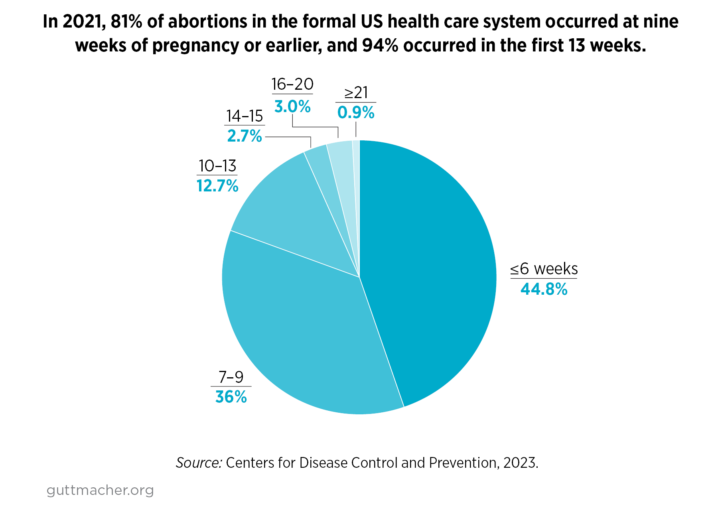
https://www.guttmacher.org/fact-sheet/induced-abortion-united-states
Notes:
Before we look at data, we want to highlight that much of the data collected in the studies we present throughout this workshop look at the experiences of cis-gender women. Studies often do not include or examine data for all birthing people. We recognize that people of all genders, including transgender and non-binary people, also experience pregnancy, use contraception, and have abortions.
Abortion is a common experience for people in the US, even though rates have declined over time. 1 in 4 women in the US (23.7%) will have an abortion by age 45. 19% of US women will have had an abortion by age 30.
In 2021, in the US:
94% of abortions in the formal US healthcare system occurred in the first 13 weeks.
81% of abortions were performed before nine weeks.
.9% of abortions were performed after 20 weeks.
Sources:
Abortion in the United States, June 2024, Fact Sheet, https://www.guttmacher.org/fact-sheet/induced-abortion-united-states
Abortion Incidence and Service Availability in the United States, 2014, https://www.guttmacher.org/journals/psrh/2017/01/abortion-incidence-and-service-availability-united-states-2014
https://www.kff.org/infographic/the-availability-and-use-of-medication-abortion-care/
https://www.guttmacher.org/article/2017/10/population-group-abortion-rates-and-lifetime-incidence-abortion-united-states-2008

Slide 8
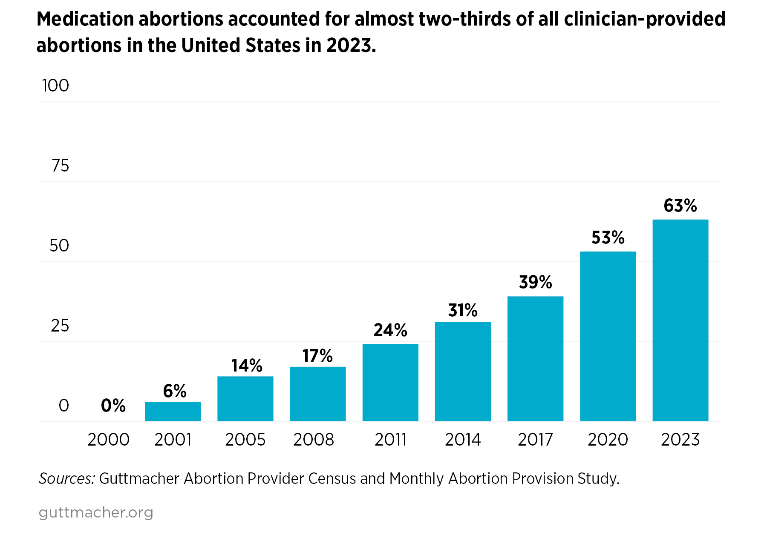
https://www.guttmacher.org/fact-sheet/induced-abortion-united-states
Notes:
In 2023, medication abortion accounted for 63% of all clinician-provided abortions in the US, up from 53% in 2020, which was the first time medication abortion crossed the threshold to become the majority of all abortions.
Medication abortion has gained broad acceptance from patients and clinicians.
This trend underscores how central this method has become to US abortion provision, especially in a severely restrictive context: over 2 decades of safe and effective use.
Reference:
Abortion in the United States, June 2024, Fact Sheet, https://www.guttmacher.org/fact-sheet/induced-abortion-united-states

Slide 9
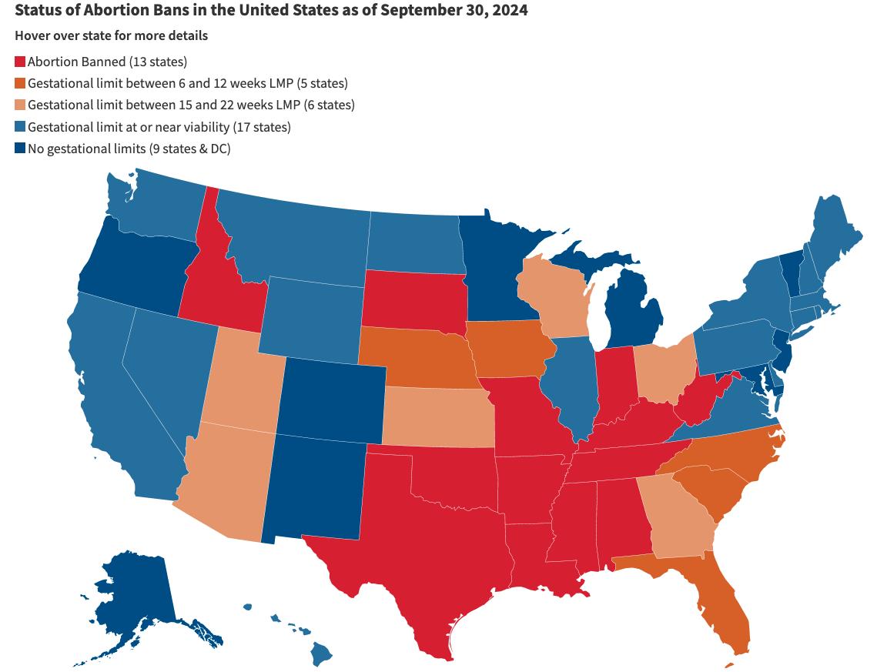
Abortion Access Inequities
https://www.kff.org/womens-health-policy/dashboard/abortion-in-the-u-s-dashboard/
Notes:
As of September 2024, 14 states have a near-total ban on abortion. And an additional 14 states restrict access to medication abortion by requiring it be provided by a physician.
State-based abortion restrictions create a deeply inequitable abortion access landscape dictating not only that access depends on where you live, but also on the resources you have to get abortion care out of state, if needed. As of 2023, nearly 1 in 5 abortion patients had to travel out of state to obtain care - doubling the pre-Dobbs rate.
Examples of these laws:
limits on gestational age
Types of procedures that are allowed
Mandated counseling
Waiting periods
TRAP laws (targeted regulations on abortion providers)
Mailing bans
In-person requirements
Ask participants: What does this patchwork of abortion access mean for people who are trying to get abortion care? What inequities do you see in abortion access? Who are the people and communities most affected? Why?
Points you may wish to highlight:
It means some people will always be able to get abortion care even if they live in a community or state that heavily restricts it or bans it.
Middle and higher income folks – who are more likely to be white than black, indigenous, or people of color – will have greater financial flexibility and resources to travel, arrange childcare and a hotel, and take time off of work to travel for abortion care.
People with lower incomes – who are more likely to be BIPOC – do not have those same kinds of resources and flexibility.
People with lower incomes also have to pay more out of pocket for their abortion because they are more likely to have Medicaid, which does not cover abortion care in these restrictive states.
Under the Hyde Amendment, federal Medicaid funds cannot be used for abortion except in extreme circumstances.
States have the option to cover abortion care with their own funds – 16 states actually do this, but these are states where abortion care is more easily accessible already.
Women of color are more likely than white women to be low income and enrolled in Medicaid: 31% Black women, 27% Hispanic women 15-44 enrolled in Medicaid compared to 16% white women
Low-income women are more likely than affluent women to have an unintended pregnancy and seek abortion care
https://www.guttmacher.org/state-policy/explore/medication-abortion
https://www.guttmacher.org/evidence-you-can-use/medicaid-coverage-abortion
https://data.guttmacher.org/states/map?topics=58&dataset=data
https://www.guttmacher.org/infographic/2021/58-us-women-reproductive-age-40-million-women-live-states-hostile-abortion-rights-0

Slide 10
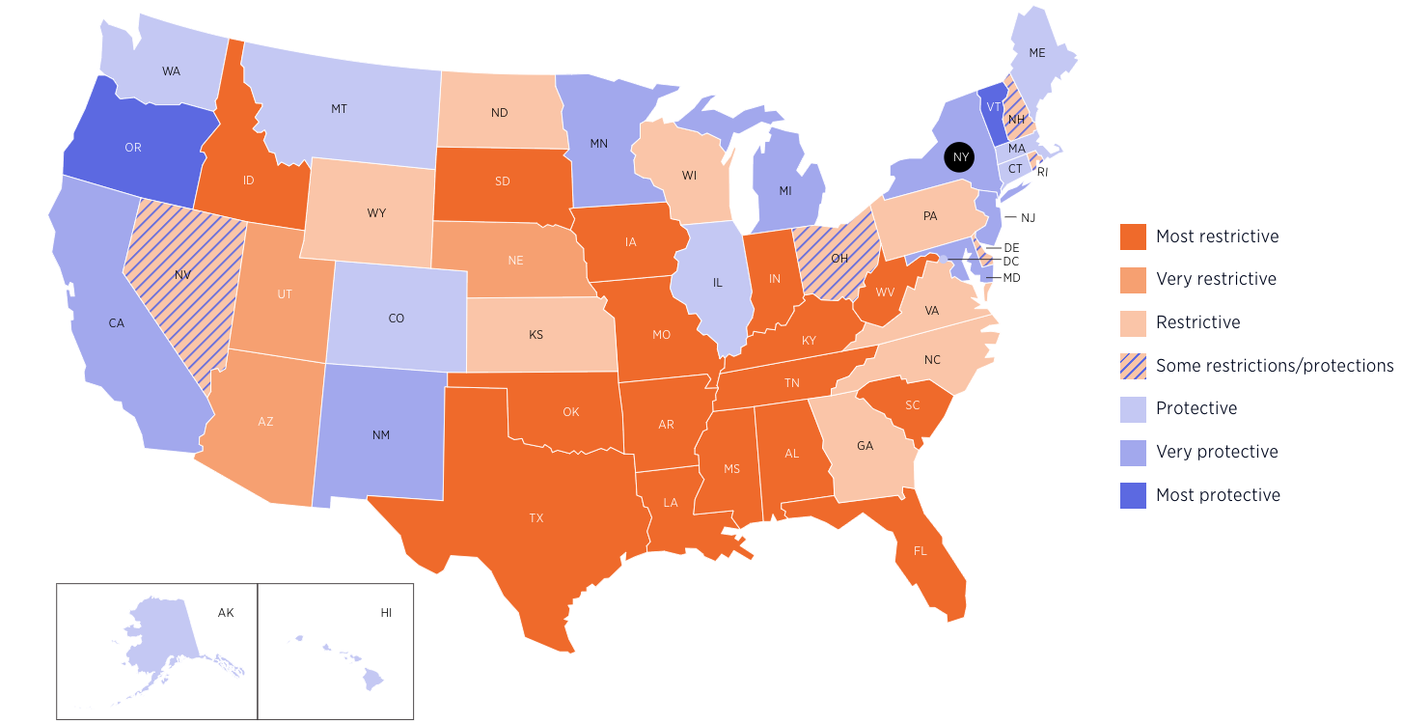
Source: https://states.guttmacher.org/policies/
Map Updated: Oct 3, 2024
Notes:
In June 2022, the Supreme Court’s decision on Dobbs v. Jackson Women’s Health overturned Roe v. Wade and Planned Parenthood v. Casey, meaning that the right to abortion would be determined by the states.
The dark orange states are considered the most restrictive, where abortion is banned completely or a 6 weeks or later, with few exceptions.
The light and pale orange states have strict regulations that restrict whether, when and under what circumstances providers can offer abortion care and a pregnant individual can obtain an abortion.
The purple-striped states have some restrictions but also some protections for abortion access.
The states in purple are where abortion care is protected by law or likely to remain protected. Many of these states represent surge states – places where people can find the nearest abortion care if you live in a state that bans abortion. The estimated number of abortions provided by a clinician in states where abortion remained legal with few restrictions increased 11.1% since the Dobbs decision.
This calls attention to the need to expand abortion access points in protective states - like through medication abortion in primary care settings and telehealth. We can alleviate the intense demand that abortion clinics are facing if we are able to provide abortion care for our own patients, within their own health center.
Optional: use this map to explore with the audience the lay of the land in your state or surrounding states: https://states.guttmacher.org/policies/abortion-policies or https://reproductiverights.org/maps/what-if-roe-fell/
Users can select any state to see details about abortion policies in place, characteristics of state residents and key abortion statistics, including driving distance to the nearest abortion clinic.
References:
Jones RK, Witwer E, Jerman J, Abortion Incidence and Service Availability in the United States, 2017, New York: Guttmacher Institute, 2019 https://www.guttmacher.org/report/abortion-incidence-service-availability-us-2017
https://states.guttmacher.org/policies/abortion-policies
https://reproductiverights.org/maps/what-if-roe-fell/?
https://states.guttmacher.org/policies/
https://www.guttmacher.org/monthly-abortion-provision-study
#wecount report April to August 2022 findings. Society for Family Planning. October 2022. doi:10.46621/ukai6324
#wecount report April 2022 to March 2023 findings. Society for Family Planning. June 2023. doi.org/10.46621/XBAZ6145

Slide 11

Who Provides Abortions?
Physicians
Advanced Practice Clinicians (nurse practitioners, certified nurse midwives, physician assistants)
Complex Family Planning certification NOT NECESSARY to provide safe abortion care
Notes:
Primary care clinicians can provide and do provide abortion care.
This includes family physicians, pediatricians, and internists -- not just OBGYNs.
This includes advanced practice clinicians like nurse practitioners, nurse midwives, and physician assistants in 23 states.
APCs aren’t limited to providing just medication abortion, they are also able to provide and are providing aspiration abortion. APCs can provide procedural and medication abortion in 20 states.
Yet, some states are passing increasingly restrictive laws to limit who is able to provide abortion care in those states. As of October 2024, 14 states (excluding ban states) require medication abortion be provided by a physician
You may have also heard of an OBGYN subspecialty in Complex Family Planning. While these fellows are receiving intensive training in abortion care and other family planning care, this sub-specialty status or accreditation is not necessary to provide safe abortion care, as stated by the National Abortion Federation’s Clinical Practice Guidelines.
References
https://prochoice.org/store/clinical-policy-guidelines/
https://www.guttmacher.org/state-policy/explore/overview-abortion-laws
Weitz, T. A., Taylor, D., Desai, S., Upadhyay, U. D., Waldman, J., Battistelli, M. F., & Drey, E. A. (2013). Safety of Aspiration Abortion Performed by Nurse Practitioners, Certified Nurse Midwives, and Physician Assistants Under a California Legal Waiver. American Journal of Public Health, 103(3), 454–461. https://doi-org.unh.idm.oclc.org/10.2105/AJPH.2012.301159
https://www.apha.org/policies-and-advocacy/public-health-policy-statements/policy-database/2014/07/28/16/00/provision-of-abortion-care-by-advanced-practice-nurses-and-physician-assistants
https://www.ansirh.org/research/publication/providing-abortion-care-professional-toolkit-nurse-midwives-nurse
https://aptoolkit.org/advancing-scope-of-practice-to-include-abortion-care/state-abortion-laws-and-their-relationship-to-scope-of-practice/
https://www.guttmacher.org/state-policy/explore/medication-abortion

Slide 12
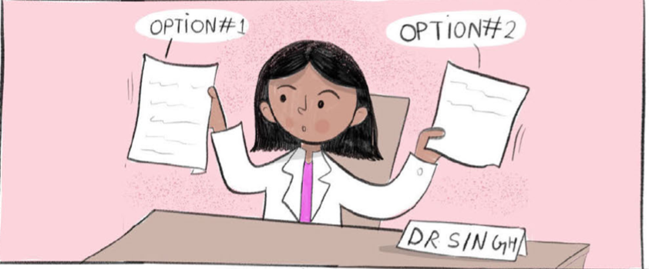
Safety of Abortion
First trimester abortions do not increase risk of:
  Infertility
  Ectopic pregnancy
  Miscarriage
  Birth defect
  Preterm or low-birthweight delivery
Image Source: Elena’s Aspiration Abortion Zine
Notes:
The most common early abortion options are medication abortion and aspiration abortion. They are both safe, effective, acceptable ways to end an early pregnancy and can be done in an outpatient setting.
Many people have misconceptions and misunderstandings about abortion that you can and should demystify: There are no increased risks of infertility, ectopic pregnancy, miscarriage, birth defect, or preterm/low birth weight delivery. Having one or more abortions does not increase any health risks or cause any of these issues.
Image Source: Elena’s Aspiration Abortion Zine, https://www.reproductiveaccess.org/resource/elenas-aspiration-abortion-zine/
Reference:
National Academies of Sciences, Engineering, and Medicine. 2018. The Safety and Quality of Abortion Care in the United States. Washington, DC: The National Academies Press. https://doi.org/10.17226/24950.

Slide 13



Medication Abortion Regimens: Three Choices
Mifepristone
Methotrexate
Misoprostol Only
+
Misoprostol
+
Misoprostol
* Mifepristone is not always available. With mifepristone, the success rate is 84% overall. With only misoprostol, the success rate is 67% overall.
Notes:
There are three different abortion regimens that use medications.
Mifepristone + misoprostol is the main regimen used currently in the US.
Methotrexate + misoprostol, which is not commonly used in the US. We’ll talk more about this regimen briefly at the end.
Misoprostol alone. We don’t know how common misoprostol alone is in the US. There are a few clinics that offer it as an option, but it is more commonly used when people self-manage or self-source their abortion outside of the medical setting.
Also to note, mifepristone + misoprostol and misoprostol alone are two evidence-based protocols for managing early pregnancy loss with medications as well.
We’ll be focusing on mifepristone + misoprostol and misoprostol alone today

Slide 14

FDA REMS on Mifepristone
No longer need to dispense mifepristone in-office
Providers & pharmacies must be “certified” to prescribe & dispense
Sign FDA patient agreement
Image Source: RHAP
Photo: RHAP
Notes:
Before looking at the protocol, it’s important to understand how these medications are regulated – because they are.
In January 2023, updates were made to the Mifepristone REMS program, no longer requiring in-person clinician dispensing and adding a pharmacy certification option. Clinicians (at least 1 per health center, others can work under the supervision of the certified prescriber) still need to become certified in order to dispense in-clinic. If you plan to send prescriptions to a certified pharmacy, each clinician who is prescribing will need to become certified and also send their Prescriber Agreement Form to the pharmacy they plan to use (this can be done the first time you send a prescription or prior).
Pharmacies will need to go through a similar certification process in order to dispense mifepristone.
Patients still need to sign the FDA Patient Agreement Form and receive the medication guide, regardless of if they are getting the medication in clinic or at a pharmacy; and regardless of if the medication is for an induced abortion or early pregnancy loss.
Can drop links in the chat:
- Sign FDA patient agreement: https://www.reproductiveaccess.org/resource/mifepristone-patient-agreement/ (can find links to all forms and multiple languages here)
- How to order mifepristone: https://www.reproductiveaccess.org/resource/order-mifepristone/
- Provider and pharmacy agreements https://www.accessdata.fda.gov/scripts/cder/rems/index.cfm?event=RemsDetails.page&REMS=390
Image Source: RHAP

Slide 15
Medication Abortion With Mifepristone + Misoprostol: Things to Know
98-99% effective
Avoids surgical and anesthetic risk
Greater patient autonomy and privacy
Less invasive
More “natural”
Bleeding can be heavy, last longer
77 days (11 weeks) gestation
Telehealth option (for some states)
Image Source: RHAP
Photo: RHAP
Notes:
So let’s imagine you are providing abortion options counseling to a patient who decides they want an abortion, but aren’t sure about which type of abortion care they want - procedural abortion or medication abortion? Your job is to counsel them on their options, presenting them unbiased, evidence-based information about the different options for abortion care and what they would find helpful to guide their decision-making.
Medication abortion mife + miso things to consider:
Highly effective (98-99%)
It’s a treatment employing counseling and medication – NOT a procedure, which avoids any surgical or anesthetic risk or discomfort
May offer enhanced privacy/sense of control & autonomy over when, where, and with whom the abortion will happen
Some people comment that it feels more “natural” as though you are having a miscarriage
Though bleeding can be very heavy and may last longer than with a procedural abortion
Takes several days to complete the abortion
Can be provided up to 77 days (11 weeks) gestation
Can also be provided by telehealth in some states. Telehealth abortion care is a safe option and for most patients, testing before a medication abortion – including ultrasound is not required for most patients. However, not at states allow telehealth for abortion care.
Can continue breast/chestfeeding without concern for side effects in infants
Resource
https://www.reproductiveaccess.org/resource/early-abortion-options/
Image Source: RHAP

Slide 16
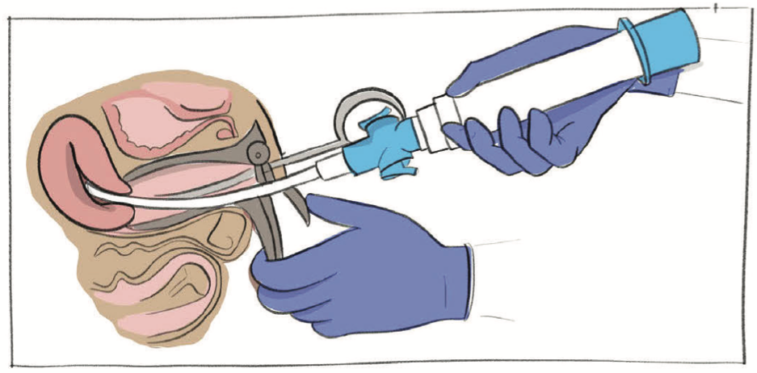
Aspiration Abortion: Things to Know
Slightly more effective (99%)
Shorter time to completion
Shorter bleeding duration
Can be performed later in gestation
Image Source: Elena’s Aspiration Abortion Zine
Notes:
The other abortion option to counsel on is aspiration abortion. Aspiration = suction/vacuum/procedural – this is not the same as D&C
Things to know about aspiration/procedural abortion:
99% effective: very rarely is there an incomplete abortion.
Shorter time to completion compared to medication abortion (procedure takes 5-10 minutes)
Shorter bleeding duration compared to medication abortion, light bleeding 1-7 days after procedure
No exposure to possible teratogens
Manual vacuum aspiration can be performed until up to 12 weeks gestation
Difference between D&C and aspiration:
Typical procedure for aspiration abortion uses simple vacuum technique with smooth cannula inserted into uterus and removes pregnancy. There is no other instrumentation to remove pregnancy other than that gentle suction. D&C is more invasive: it uses cutting rather than suction. D&C is not an indication for abortion up to 16 weeks if you can safely exit with a vacuum aspiration.
Image Source: Elena’s Aspiration Abortion Zine

Slide 17
Misoprostol Route and Timing
Misoprostol Route | Buccal/sublingual | Vaginal
Misoprostol Dose | Up to 9 weeks: 1 dose, 800 mcg
 | 9-11 weeks: 2 doses, 800 mcg each
Misoprostol Timing | Up to 9 weeks 24-48 hours after Mifepristone | Up to 9 weeks 6-72 hours after Mifepristone
 | 9-11 weeks 2nd Dose: 4 Hours after 1st miso dose
Notes:
Now let’s go over the protocol for medication abortion with mifepristone and misoprostol and work through some case study examples.
Gestational age limit
77 days
Mifepristone dose
200 mg oral
Can be taken in office (if you dispense in-office) if the patient wants or at home at a time of their convenience
Misoprostol Dose
There are three effective routes to take the misoprostol, buccal, sublingual and vaginal. Buccal means the misoprostol is held and absorbed in the patient’s cheeks for 30 minutes, then they swallow the pills with a drink. Sublingual means the misoprostol is held and absorbed under the patient’s tongue for 30 minutes, then they swallow the pills with a drink. Vaginal means the person inserts misoprostol pills into their vagina and they lay down for 30 minutes for their body to absorb the pills. If the pills fall out, the person can throw them away.
You’ll see a distinction of miso dose and timing by gestational age (up to 9 weeks and between 9-11 weeks) for both methods. The second dose helps to enhance efficacy of completing the medication abortion for those in 9-11 weeks gestation.
Up to 9 Weeks Buccal/Sublingual
1 dose of misoprostol of 800 mcg (4, 200 mcg tablets). Take 24-48 hours after mifepristone. Hold in cheeks for 30 minutes, two pills inside each cheek.
9-11 Weeks Buccal/Sublingual
Take first dose of misoprostol 24-48 hours mifepristone. Take second dose (4, 200 mcg tablets = 800 mcg) 4 hours after the 1st miso dose.
Up to 9 Weeks Vaginal
1 dose of misoprostol 800 mcg (4, 200 mcg tablets). Take 6-72 hours after mifepristone. Insert in vagina and lay down for 30 minutes.
9-11 Weeks Vaginal
Take first dose of misoprostol 6-72 hours mifepristone. Take that second dose (4, 200 mcg tablets = 800 mcg) 4 hours after the 1st miso dose. If bleeding has already started, taking the second dose buccally is also an option.
*Refer to aftercare sheets for patients to have instructions on remembering this, or the simplified how to use abortion pills handout.
Office follow-up visit – later we’ll talk about what to follow-up on. It’s good to offer a follow-up appointment or phone call. Often, a phone call check-in is more than enough. Recommend f/u 7-14 days after mifepristone to get a sense of how the patient is doing and if the abortion is complete. But, follow-up is not routinely required.
RHAP Resources to Reference - may drop in chat
https://www.reproductiveaccess.org/wp-content/uploads/2020/08/abortion-pills-protocol-1.pdf
https://www.reproductiveaccess.org/resource/medication-abortion-aftercare-instructions-vaginal-miso/
https://www.reproductiveaccess.org/resource/medication-abortion-aftercare-instructions-buccal/
References for extended gestational limit
Beverly W, Dzuba IG, Chong E, et al. Extending Outpatient Medical Abortion Services Through 70 Days of Gestational Age. Obstetrics & Gynecology. 2012;120(5):1070-1076. doi:10.1097/AOG.0b013e31826c315f.
Bracken, H., N.T.N. Ngoc, E. Schaff, K. Coyaji, S. Ambardekar, E. Westheimer, B. Winikoff. Mifepristone Followed in 24 Hours to 48 Hours by Misoprostol for Late First-Trimester Abortion. Obstetrics and Gynecology (Apr 2007), 109 pp.895-901.
Kapp N, Eckersberger E, Lavelanet A, Rodriguez MI. Medical abortion in the late first trimester: a systematic review. Contraception. 2019;99(2):77-86. doi: 10.1016/j.contraception.2018.11.002.
Schaff EA, Fielding SL, Eisinger SH, Stadalius LS, Fuller L. Low-dose mifepristone followed by vaginal misoprostol at 48 hours for abortion up to 63 days. Contraception. Jan 2000;61(1):41-46.
Schaff EA, Fielding SL, Westhoff C. Randomized trial of oral versus vaginal misoprostol 2 days after mifepristone 200 mg for abortion up to 63 days of pregnancy. Contraception. Oct 2002;66(4):247-250.
References for lower mifepristone dose
Li C-L, Chen D-J, Song L-P, et al. Effectiveness and Safety of Lower Doses of Mifepristone Combined With Misoprostol of the Termination of Ultra-Early Pregnancy: A Dose-Ranging Randomized Controlled Trial. Reproductive Sciences. 2014;22(6):706-711.
Weeks AD and Stewart P. The use of low dose mifepristone and vaginal misoprostol for first trimester termination of pregnancy. Br J Fam Planning 1995;21:85-86.
World Health Organization Task Force on Post-Ovulatory Methods of Fertility Regulation. Comparison of two doses of mifepristone in combination with misoprostol for early medical abortion: a randomized trial. BJOG 2000 107(4): 524-530
Schaff EA, Eisinger SH, Stadalius LS, Franks P, Gore BZ, Poppema S. Low-dose mifepristone 200 mg and vaginal misoprostol for abortion. Contraception. Jan 1999;59(1):1-6.
References for higher misoprostol dose
Coyaji,K., U. Krishna, S. Ambardekar, H. Bracken, V. Raote, A. Mandlekar, B. Winikoff. Are two doses of misoprostol after mifepristone for early abortion better than one? British Journal of Obstetrics and Gynaecology, (Mar 2007), 114 (3), pp. 271–278.
Castillo P, Sanhueza P, Hernandez EML, Bousieguez M, Dzuba I. Does a repeat dose of 800mcg misoprostol following mifepristone improve outcomes in the later first trimester? A retrospective chart review in Mexico City. Paper presented at: National Abortion Federation Annual Meeting; April 22, 2017; Montreal, Quebec.
References for non-oral misoprostol route
Schaff EA, et al. Vaginal misoprostol administered at home after mifepristone (RU486) for abortion. J Fam Pract 1997;44:353-60.
Schaff EA, Fielding SL, Westhoff C. Randomized trial of oral versus vaginal misoprostol at one day after mifepristone for early medical abortion. Contraception. Aug 2001;64(2):81-85.
Schaff EA, Fielding SL, Westhoff C. Randomized trial of oral versus vaginal misoprostol 2 days after mifepristone 200 mg for abortion up to 63 days of pregnancy. Contraception. Oct 2002;66(4):247-250.
Winikoff B. Oral vs buccal administration of misoprostol after mifepristone for medication abortion up to 63 days. Obstetrics and Gynecology 2008, accepted for publication.
References for misoprostol timing
Guest J, Chien P, Thomson M, Kosseim ML. Randomised controlled trial comparing efficacy of same day administration of mifepristone and misoprostol for termination of pregnancy with the standard 36- to 48-hour protocol. Bjog. Oct 2005;112(10):1457.
Schaff EA, Fielding SL, Westhoff C, et al. Vaginal misoprostol administered 1, 2, or 3 days after mifepristone for early medical abortion: A randomized trial. Jama. Oct 18 2000;284(15):1948-1953.
Shannon C., E. Wiebe, F. Jacot, E. Guilbert, S. Dunn, W.R. Sheldon, B. Winikoff. Regimens of misoprostol with mifepristone for early medical abortion: a randomised trial. British Journal of Obstetrics and Gynaecology (Jun 2006), 113(6), pp 62-628.
Creinin MD, Fox MC, Teal S, Chen A, Schaff EA, Meyn LA: MOD Study Trial Group: A randomized comparison of misoprostol 6 to 8 hours versus 24 hours after mifepristone for abortion. Obstet. Gynecol. 2004 103(5 Pt. 1): 851-859

Slide 18
Mifepristone
Causes progesterone blockade
Decidual necrosis
Cervical ripening
Detachment
Misoprostol
Causes uterine cramping and expulsion
Notes:
How does mifepristone and misoprostol actually work?
Mechanism of Mifepristone-induced Abortion:
Mifepristone, an anti-progesterone, interferes with early pregnancy by competing with progesterone, causing:
decidual necrosis - edema, dissociation of capillary walls and cytoplasmic lysis of decidual cells; and
cervical ripening - softening and dilation of the cervix.
This prevents pregnancy from growing.
These effects occur within a few hours after mifepristone administration.
Misoprostol
Prostaglandin: causes cervical softening, uterine contractions, and expulsion of pregnancy
References:
Baird D. Mode of action of medical methods of abortion. JAMWA. 2000; 35(3): S121-126.
Herrmann WL et al. Effects of the antiprogesterone RU 486 in early pregnancy and during the menstrual cycle. Future aspects in contraception. 1984 Ch. 22:249-70.
Swahn ML, Cekan S, Wang G, Lujndstrom V, Bygdeman M. Pharmacokinetic and clinical studies of RU 486 for fertility regulation. In: Beaulieu EE, Siegel S, eds. The Antiprogestin Steroid RU 486 and Human Fertility Control. New York, NY: Plenum; 1985:249-258.

Slide 19

PATIENT CASE:
Yolanda
22 years old
She/her pronouns
Requests a pregnancy test
In-clinic
Image Source: https://unsplash.com/photos/Wh-Gj7ADV6s (by Omar Lopez on Unsplash)
Notes:
[Pause and ask audience if there are any questions]
Let’s walk through a case study of an in-clinic medication abortion to demonstrate the various steps and important counseling points.
Yolanda’s last menstrual period was 6 weeks ago: she’s certain of the date.
Her pregnancy test is positive.
She tells you she’s married, with a young son; she works full-time and will complete college in 1 year; she is not ready to have another child.
NOTE: It’s not necessary to ask why someone wants an abortion, but sometimes our patients tell us about what’s going on in their lives and what’s bringing them to this decision.
Image Source: https://unsplash.com/photos/Wh-Gj7ADV6s (by Omar Lopez on Unsplash)

Slide 20

Counseling Yolanda
Review options
Ensure the decision is hers
Assess home/living situation
Image Source: Photo by Omar Lopez on Unsplash https://unsplash.com/photos/Gx5-zf_HE9w
Notes:
How do we approach our conversation with Yolanda?
Counseling
First may be pregnancy options counseling. This is simple for people who are firm in their decision – and it’s more complex for someone who is unsure.
Always ask permission if you can share and explore other options. Take a non-judgmental, trauma-informed approach to counseling
The options for a positive pregnancy test include: continuing the pregnancy and parenting, continuing the pregnancy and adoption, or abortion: medication/aspiration abortion if in early pregnancy.
If someone is sure, then that is the decision we support them with. Trust patients as the experts of their own health care.
But you do want to determine that she wants an abortion -- make sure it is Yolanda, not a mother/husband/partner anyone else, who thinks they should have an abortion.
Overall, our role is to facilitate the patient’s choice or help them navigate their feelings and emotions if they are unsure or conflicted about that decision.
Yolanda is sure she wants an abortion and we are certain that the decision comes from her, then review abortion options: medication abortion and aspiration.
Image Source: Photo by Omar Lopez on Unsplash https://unsplash.com/photos/Gx5-zf_HE9w
Resources
NAF Clinical Guideline 2022: https://prochoice.org/providers/quality-standards/
https://rhedi.org/education/rhedi-curriculum/patient-centered-pregnancy-options-counseling/
https://www.all-options.org/

Slide 21

Yolanda: Next Steps
Establish gestational age
Rule out contraindications:
          Allergy to meds
          Chronic adrenal failure
          Long-term systemic corticosteroid therapy
          Anticoagulant use (excluding aspirin)
          IUD in place
          No access to follow-up
          Ectopic Pregnancy
          Create safety plan, if needed
          Indications for sonography
Photo Source: Unsplash by Omar Lopez https://unsplash.com/photos/0-uzdU3gUYw
Notes:
Yolanda wants a medication abortion, so we move forward to assess if she has any contraindications.
1. Establish gestational age: MAB with mifepristone and misoprostol can be done up to 77 days
Yolanda is certain of her last menstrual period. Last LMP is a really good indicator for establishing GA. Studies show that people are accurately able to remember their LMP – this emphasizes the importance of trusting our patients with information about their own health.
Other ways to confirm
Size = dates based on bimanual exam. Not always necessary, but could be offered if there is uncertainty.
If any doubts or discrepancy between LMP and bimanual: could order or perform a sonogram/ultrasound to establish GA.
2. Rule out contraindications:
Mifepristone is an anti-progestin and anti-steroid – want to see if Yolanda has a history of chronic adrenal failure or long-term systemic corticosteroid therapy in efforts to not precipitate adrenal crisis. Nasal, inhaled, or topical steroids are okay.
Pregnancy with IUD in place is likely going to be an ectopic pregnancy -- mifepristone & misoprostol will not work for an ectopic pregnancy
Ask: Any other contraindications?
It’s also important to help Yolanda think about her home/living situation
Will she need a support person to help care for her 2-year-old while she is cramping/bleeding?
Is there anyone in Yolanda’s home who may become violent if they find out what is going on?
Medication abortion is private, but as it’s happening, it’s hard to keep it a secret from those who live with the person experiencing it.
How to assess safety, specifically intimate partner violence:
Do you feel safe in your current relationship? (Note: With pregnancy options counseling, it’s good to ask if anyone is forcing the patient to have an abortion and if anyone is supporting them through the process. In this conversation you may learn whether the patient feels safe in their current relationship)
OPTIONAL: If Yolanda says that there may be an issue of intimate partner violence if her husband find out what’s going on, how can you support Yolanda navigate this situation at home and keep her abortion private from her partner? Some examples:
MAB cannot be distinguished from an EPL (unless there is pill residue). Can discuss writing letters from you as their provider stating "patient was pregnant, no longer pregnant."
Consider providing electronic copies of instructional materials or sharing a website with patient instructions to prevent a partner from finding paperwork related to the abortion.
Does she have a private place to store mifepristone (if not taken immediately) and misoprostol prior to taking it? Will she be able to get to a pharmacy to pick up other medicines (i.e. pain/anti-nausea medicines)? Will she be able to take the misoprostol in private? Is birth control sabotage happening/being forced to become pregnant? These are conversations to consider having with her and following up on in future appointments.
If Yolanda really wants to keep this a secret, consider recommending that she take misoprostol buccally to avoid the risk of finding pill fragments in the vagina hours later.
Discuss Safe Horizons or other local IPV organizations. Have Yolanda save the hotline phone number in their phone under an alias name.
Consider talking to Yolanda about identifying a person (friend/family) who could be informed of the safety concern
Potentially identify a place to stay if Yolanda is living in an unsafe situation.
Recommend scheduling a follow-up visit to check-in about safety
Photo Source: Unsplash by Omar Lopez https://unsplash.com/photos/0-uzdU3gUYw

Slide 22
Indications for Sonography: Ultrasound As Needed Protocol
Uncertain last menstrual period (LMP)
No menses after delivery, abortion, recently taking or stopping contraception
Gestational age by LMP > 77 days
Size/date discrepancy or uncertainty
History of/suspected ectopic or ectopic risk factors
Notes:
NAF 2024 clinical guideline state: “The use of ultrasound is not a requirement for the provision of first trimester abortion care.” It is acceptable to confirm gestational age prior to abortion with a sure LMP with or without uterine size on pelvic exam that is consistent with gestational age.
Requiring ultrasound can limit access to medication abortion care due to the high costs for clinic, difficulty obtaining necessary training, lack of availability of ultrasound in primary care/outpatient settings, financial cost to patients, delays in care for getting that one extra step, and patient discomfort or trauma related to GYN exams. Minimizing the need for ultrasound is important for enhancing timely and accessible care in a way that meets patients preferences and needs.
A sonogram is indicated in the following situations:
Uncertain LMP or no menses after delivery, abortion, recently taking or stopping contraception
If gestational age is over 77 days by patient LMP → if there is ultrasound on-site, consider performing ultrasound first (if the patient prefers MAB over aspiration) to confirm GA. If the ultrasound is off-site, consider bimanual exam first. If exam is consistent with <11 weeks, proceed with MAB.
Size/date discrepancy or uncertainty
History of/suspected ectopic or risk factors for ectopic (history of ectopic, PID history, tubal surgery in past): mife and miso will not induce abortion if it is an ectopic pregnancy, will not treat ectopic.
Assess for ectopic risk: history of previous ectopic, becoming pregnant with IUD in place, vaginal bleeding, unilateral pelvic pain, adnexal mass on exam
If low suspicion of ectopic: discuss ease, comfort, and cost of sonogram vs. initiating medication abortion with close (3 day) follow-up
If high-suspicion of ectopic: provide or refer for definitive care as appropriate
If we can get good history and be sure about our history, MAB is safe and effective without US.
References:
NAF 2022 Clinical Guidelines: https://prochoice.org/wp-content/uploads/2024-CPGs-FINAL-1.pdf
https://rhedi.org/limited-ultrasound-protocol-for-medication-abortion/
https://www.reproductiveaccess.org/resource/indications-sonography-medication-abortion/

Slide 23

Providing the medications to Yolanda
Gestational age: 6 weeks
Patient agreement
Image Source: https://unsplash.com/photos/a8cWVqHa0nA by Omar Lopez on Unsplash
Notes:
Note on Rh testing
Based on current practice guidelines, it is reasonable to forego Rh testing for MAB up to 77 days LMP (NAF Clinical Guidelines)
WHO & NAF suggests no Rh testing/rhogam necessary up to 12 weeks LMP for MAB or procedural abortion.
Institutional policies may vary and it is important to be familiar with the standards for your practice setting
What’s important is using shared decision-making with your patient -- counseling on probability of risks and allowing the patient to come to an informed conclusion of what works best for them. The risk of fetal Rh alloimmunization is very low in first trimester and likely beyond.
To recap: We walked through the patient’s history: Yolanda’s LMP indicates 6 weeks gestational age. We helped her develop a safety plan for home and she still wants a medication abortion. We’re sure about no other contraindications to MAB. We’re almost ready to dispense medications…
The FDA patient agreement form provided by the manufacturer of mifepristone (who may be GenBioPro or Danco depending on where your clinic contracts with) must be signed by the patient. But this agreement is different from a typical consent form. Consent forms can also be provided remotely for telehealth appointments, through services like DocuSign, etc.
Patient agreements:
GenBioPro Patient Agreement (generic):
https://genbiopro.com/resources-provider/
Download patient agreement to get the latest version, other languages also available
Danco Patient Agreement (branded):
https://www.earlyoptionpill.com/for-health-professionals/patient-support-materials/
download patient agreement form, multiple languages also available
Resources:
WHO Safe Abortion Guidelines, https://www.who.int/publications/i/item/9789240039483
NAF 2022 Clinical Guidelines: https://prochoice.org/providers/quality-standards/
Image Source: https://unsplash.com/photos/a8cWVqHa0nA by Omar Lopez on Unsplash

Slide 24
Anticipatory Guidance
Anticipatory Guidance: within 24 hours – cramping, heavy bleeding, clots, sometimes GI side effects
Yolanda takes mifepristone in your office, or later at home
At home, Yolanda takes pain meds, then misoprostol
Notes:
What happens in your office next?
You counsel Yolanda on how to take the pills and what to expect. Offer a handout on MAB aftercare instructions so she can refer back to this.
Yolanda can take mifepristone in the office or at home. She chooses to take it in the office. You advise her that she probably won’t have any symptoms until she uses misoprostol at home. She may have some spotting, or may have nothing at all. This is normal.
Anticipatory Guidance: within 24 hours after taking misoprostol, patient can expect:
Bleeding: The heaviest bleeding (usually heavier than with menses) will likely occur several hours after taking the Misoprostol and will last 1-2 days. Bleeding/spotting is typical up to 9-16 days. A small number of patients (8%) may experience some type of bleeding for 30 days or more. The amount and duration of bleeding is likely to increase with gestational age. There is a very small risk of prolonged bleeding requiring uterine aspiration. The patient should be instructed in how much bleeding would be considered excessive (e.g. patient is soaking through more than 2 pads per hour for 2 hours in a row) and when to call the clinician. The size of the pregnancy tissue increases with gestational age. You can use these pictures to help prepare patients for what they should expect to see based on their gestational age.
Cramping and uterine pain: Cramping is expected for up to a few days.
There are other commonly reported side effects, that should not last longer than 24 hours after taking misoprostol. If these last longer, patient should be instructed to contact the office to determine if they should seek care. These include:
-Diarrhea, nausea, and vomiting
-Weakness
-Fever/chills
-Headache
-Dizziness
GI-related side effects are more common with buccal/sublingual administration of miso. (patients sometimes may call about these symptoms)
Next steps:
Give misoprostol pills (or a prescription for these from a local pharmacy) with instructions for their use at home.
Offer prescriptions for pain medication to take at home (usually ibuprofen up to 800 mg = 4, 200-mg pills; up to 2 220-mg naproxen pills, or up to 2 500-mg acetaminophen pills, or a mild narcotic) or advise taking whatever the patient normally takes for menstrual cramps. Advise patient to take it shortly before taking misoprostol in anticipation of some cramping.
*If the patient is not having any bleeding after using misoprostol, the patient should reach out.
*For fever, we can expect a fever/chills during first 24 hours after misoprostol. Risk of infection is VERY low, but we’d want to hear if the patient is having sustained fevers.
For those around 10-11 weeks gestation, consider discussing identifiable products of conception as part of anticipatory guidance.
Heavy Bleeding Guidance: 2x2 rule.
Call if bleeding soaks through more than two maxi pads/hour for 2 consecutive hours.
We’ll go through more examples later about how to triage this situation.
Talk about contraception if interested
Depending on a patient’s medical eligibility, these contraceptive methods are safe and effective post-abortion though timing may differ on when the person can start the contraception.
Estrogen/progestin pill, patch, ring (can start same day they use mifepristone)
Progestin-only pill, depo injection, implant (can start same day they use mifepristone though some evidence that depo injection decreases effectiveness of mifepristone)
IUD can be inserted 4 days after misoprostol
Barrier methods (can start same day they use mifepristone)
If the patient starts contraception more than 7 days after taking mifepristone, advise on using back-up methods like condoms for the first 7 days.

Slide 25
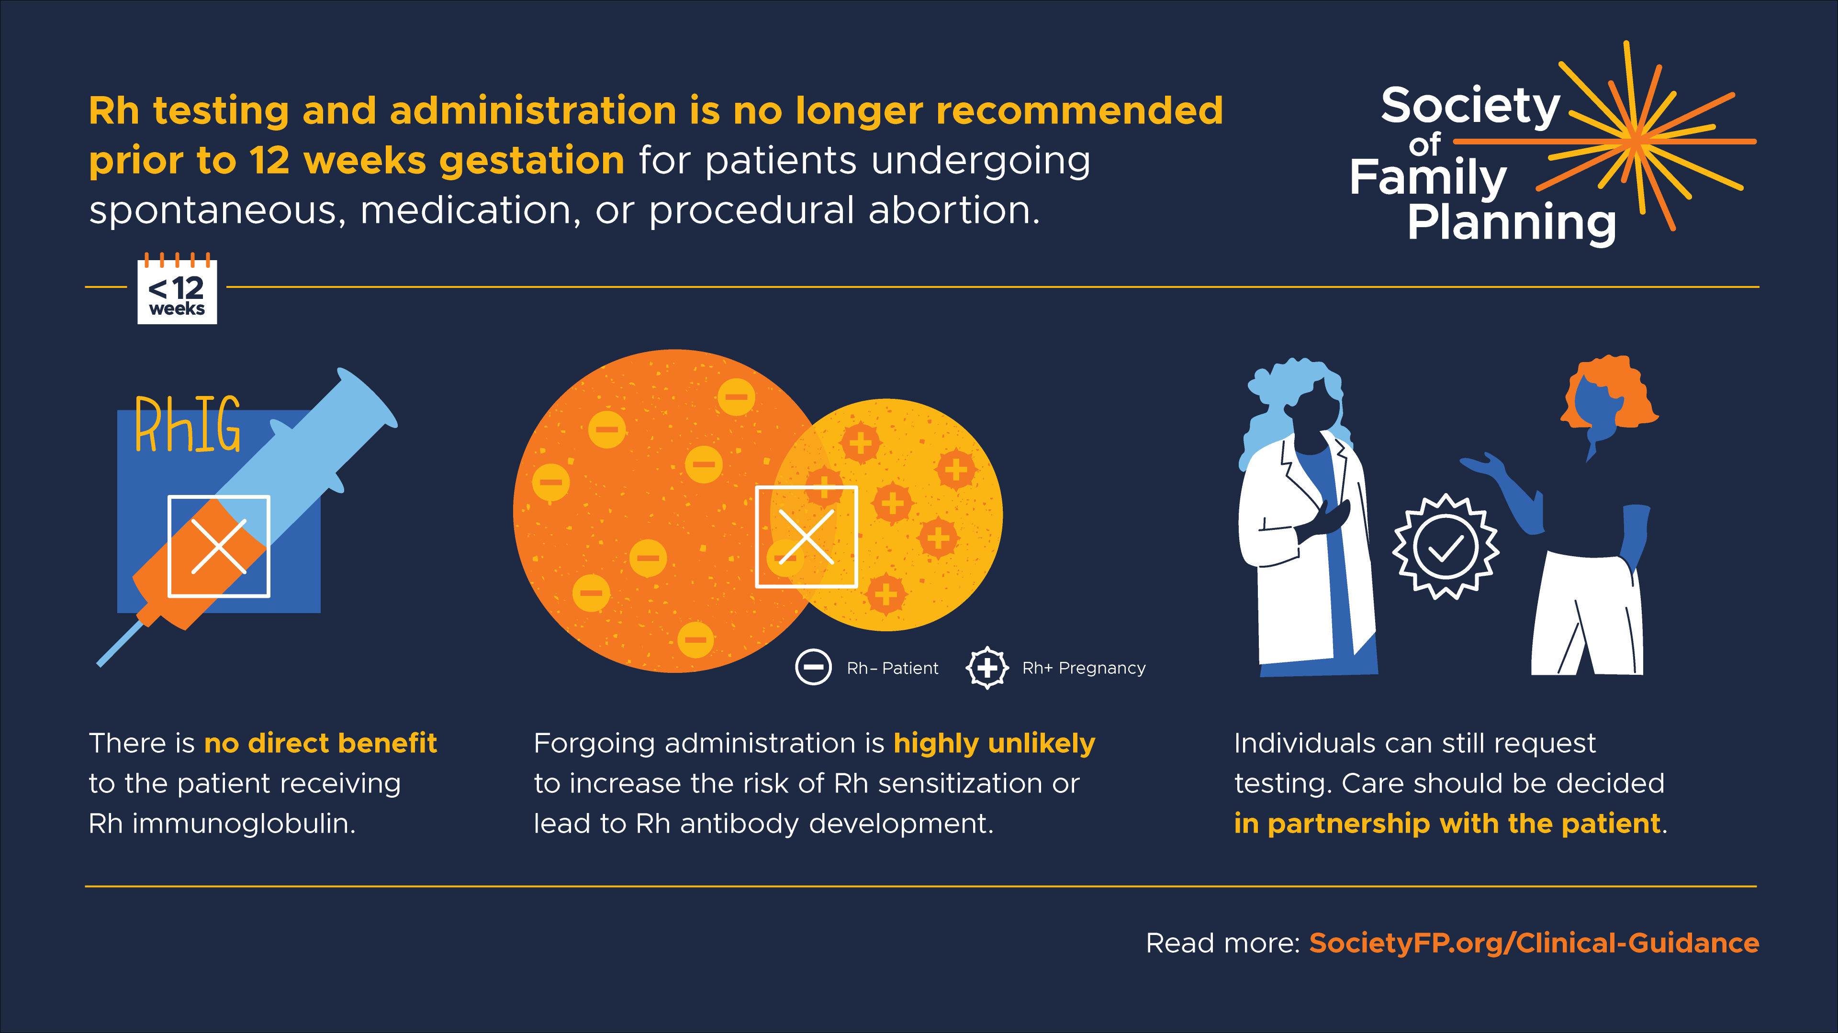
Notes:
Slide from Society of Family Planning
https://societyfp.org/clinical-guidance/

Slide 26
Options for Contraception
Same Day: estrogen/progestin pill, patch, ring, implant, progestin-only pill, barrier methods
Same Day: DMPA injection (may decrease mifepristone effectiveness)
4 Days After Misoprostol: IUD
Advise on back-up methods if patient starts contraception more than 7 days after mifepristone
Notes:
Talk about contraception if interested
Depending on a patient’s medical eligibility, these contraceptive methods are safe and effective post-abortion though timing may differ on when the person can start the contraception.
Estrogen/progestin pill, patch, ring (can start same day they use mifepristone)
Progestin-only pill, depo injection, implant (can start same day they use mifepristone though some evidence that depo injection decreases effectiveness of mifepristone)
IUD can be inserted 4 days after misoprostol
Barrier methods (can start same day they use mifepristone)
If the patient starts contraception more than 7 days after taking mifepristone, advise on using back-up methods like condoms for the first 7 days.
Sources
Cansino C, Lichtenberg ES, Perriera LK, et al. Do women want to talk about birth control at the time of a first-trimester abortion? Contraception. 2018 Dec;98(6):535-540. doi: 10.1016/j.contraception.2018.08.005.
Curtis KM, Jatlaoui TC, Tepper NK, et al. U.S. selected practice recommendations for contraceptive use, 2016. MMWR Recomm Rep. 2016;65(4):1.
Denny C. How to start birth control after an abortion. Bedsider website. August 2019. Accessed May 2021. https://www.bedsider.org/features/1319-how-to-start-birth-control-after-an-abortion.
Jain J, Dutton C, Nicosia A, et al. Pharmacokinetics, ovulation suppression and return to ovulation following a lower dose subcutaneous formulation of Depo-Provera. Contraception. 2004;70(1):11.
Matulich M, Cansino C, Culwell KR, Creinin MD. Contraception. Understanding women’s desires for contraceptive counseling at the time of first-trimester surgical abortion. 2014;89(1):36.
Raymond EG, Weaver MA, Louie KS, et al. Effects of depot medroxyprogesterone acetate injection timing on medication abortion efficacy and repeat pregnancy random controlled trial. Obstet Gynecol. 2016;128(4):739.
Raymond EG, Weaver MA, Tan YL, et al. Effect of immediate compared with delayed insertion of etonogestrel implants on medical abortion efficacy and repeat pregnancy: A randomized controlled trial. Obstet Gynecol. 2016 Feb;127(2):306-12.
https://www.reproductiveaccess.org/resource/contraceptive-pearls-post-abortion-contraception/

Slide 27
Options for Follow Up
Follow-up is not required, but can be offered
Patient-driven follow-up: repeat home pregnancy test in 4 weeks
Follow-Up Points:
  Assure completion: 4 cardinal questions
  Process experience
  Review contraceptive choice, if desired
Notes:
You end the visit by giving Yolanda information on how to reach the on-call provider who is available to answer questions if needed (My Chart Message, phone number)
Routine follow-up is not required or necessary in most cases, it mainly serves to confirm whether the abortion is complete and to talk through any side effects or concerns.
You can offer to schedule Yolanda an in-person or telehealth visit to follow-up in 7-14 days to ensure the abortion is complete. You can also follow-up by phone instead of a formal visit.
You encourage Yolanda to do her own follow-up too, with another home pregnancy test in 4 weeks: at home pregnancy tests are highly sensitive and may still show as pregnant if done before 4 weeks.
If you follow-up with the patient over phone, video, or in-person, use these 4 cardinal questions to assess complete abortion:
Did you take the pills?
Did you have bleeding?
Did you have cramping?
Do you still feel pregnant?
Some pregnant people have pregnancy symptoms (breast tenderness, nausea). So it’s important to document those in your initial visit, and follow up on those symptoms to assess if the MAB is complete and the person isn’t pregnant anymore.
If the person comes in for a follow up visit AND if a beta hCG was taken in the initial visit, you can follow up on that and draw a sequential beta and evaluate the trend (decline). You can offer a sonogram to visualize if the pregnancy has been evacuated from the uterus. This is only needed in some cases:
If history not consistent with successful medication abortion (no bleeding or cramping)
Patient reports still feeling pregnant
Serum HCG has not declined by 60% in 2-3 days or by 90% in 1 week
No initial HCG was drawn and urine HCG is still positive more than 3 weeks later
It can also be helpful to process the experience. It can be normal for patients to be dealing with different emotions or not having any emotions about it at all. It’s good to leave space for that kind of conversation if the patient wants. You may want to make connections to post-abortion counseling services like Exhale (https://exhaleprovoice.org/) or counseling/support services in your own clinic, if the patient would like this.
Review contraceptive choice if interested.

Slide 28
Phone Calls After Medication Abortion
“There wasn’t much blood.”
“Am I still pregnant?”
Was there some bleeding? Any cramping? Did you take the misoprostol?
Ask if pregnancy symptoms have disappeared.
“I’m bleeding and cramping a lot.”
“I’m still bleeding after 2 weeks.”
That’s normal unless you’re soaking two heavy pads an hour for two consecutive hours.
That’s normal unless you’re soaking two heavy pads an hour for two consecutive hours.
Offer follow-up appointment.
Notes:
Before follow-up, patients may call with symptoms that worry them. For the vast majority, the only necessary interventions are listening and reassuring.
There wasn’t much blood.
Ask: Was there some bleeding? Any cramping? Did you take the misoprostol?
For folks in the 9-11 week protocol, ask: did you take 2 doses of misoprostol?
I’m bleeding and cramping a lot.
Reassure: bleeding and cramping are normal, unless the 2x2 rule applies – if you are soaking through 2 pads an hour or more for 2 consecutive hours.
Am I still pregnant?
Ask: do you still feel pregnant? Have your pregnancy symptoms disappeared?
I’m still bleeding after 2 weeks.
Ask about 2x2 rule? If the bleeding is very heavy, ask for the patient to come in.
Offer a follow up appointment if they are concerned.
Note to facilitator: Feel free to share other commonly asked questions you may have received from patients. You can also check out more FAQs people ask about MAB if you want to foster more discussion on this topic: https://www.reproductiveaccess.org/resource/medication-abortion-faqs/

Slide 29

PATIENT CASE:
Ty
28 years old
They/them pronouns
Took a pregnancy test
Booked telehealth appointment with you.
Image source: https://genderphotos.vice.com/
Notes:
Note to Facilitator: As of October 2024, 20 states ban the use of telehealth medication abortion and 4 states require a hybrid model. If the audience works primarily in states where telehealth medication abortion is banned, feel free to skip this case study.
Let’s walk through a situation where someone comes to you for a telehealth medication abortion.
Telehealth care for medication abortion: overall, the clinician should counsel the patient by phone or video about pregnancy options. Those who choose medication abortion can be counseled about the process. Patient information sheets can be emailed, faxed, texted through patient portals. And, the medications can be mailed directly to the patient.
Image source: https://genderphotos.vice.com/
Reference:
https://www.rhites.org/tmab-map
https://www.kff.org/womens-health-policy/slide/state-restrictions-on-telehealth-abortion/

Slide 30
Telehealth Medication Abortion Discussion Points
Abortion options counseling
Medical history, including LMP for gestational dating
Review of expected effects & signs to call clinician
Explain protocol and steps for taking mifepristone and misoprostol
E-sign patient agreement
Talk about options for getting the pills: mailing, pharmacy, or in-office pick up
Offer follow-up visit in-person, via telehealth/phone call
Notes:
Initial assessment – discussion of MAB for Ty
Abortion options counseling
Review of expected effects of medication abortion (ask the audience what those effects are):
Bleeding and cramping, heavier than with menses, are expected.
Diarrhea and gastrointestinal effects are common
Small risk of prolonged bleeding requiring aspiration/MVA
Explain protocol: explain process and steps to patient
Explain situations where the patient should call you (more than 2 soaked pads per hour for two hours in a row)
Note: there may be state requirements to comply with like mandatory waiting periods, parental notification, etc. Consult with Center for Reproductive Rights for more information (reproductiverights.org)
Take Medical History
Confirm Ty did home urine pregnancy test
Rule out contraindications (ask audience what they are)
Ensure Ty has access to a phone
Obtain gestational dating (LMP): follow ultrasound as needed protocol
Reminder, it’s reasonable to forego Rh testing for MAB up to 77 days LMP. WHO & NAF recommend 12 weeks. If Ty is RH negative or unknown, discuss the risks of not administering Rh immunoglobulin and risk of Rh isoimmunization/poor fetal outcomes and the probability of both. Support your patient to come to an informed conclusion of what works best for them. Rh positive = no labs.
Agreements and Dispensing
Review patient agreement and consent form – this can be done verbally or you can send the forms via patient portal through DocuSign or other platforms depending on your institution
Verbal consent may be acceptable in certain states
Talk about options for getting the pills: mailing, pharmacy, or in-office pick-up
Follow-Up
Make sure Ty knows how to reach you or another clinician on call
Review plans for contraception if Ty is interested
Offer follow up visit or phone call in 7-14 days → Follow-up not required, it’s just recommended.
Resources:
https://familymedicine.uw.edu/accessdelivered/
https://www.reproductiveaccess.org/resource/telehealth-care-for-mab-protocol/
https://www.reproductiveaccess.org/resource/telehealth-care-for-mab-workflow/

Slide 31
Options for Picking up Mifepristone
Mail from the health center
  Include mifepristone, 4-8 200mcg pills of misoprostol, pain medicine, urine pregnancy test, instruction sheet in package
Mail order pharmacy
  HoneyBee, American Mail Order Pharmacy, Manifest
Pharmacy dispensing
  CVS and Walgreens in many states are certified to dispense
  Local/independent pharmacies may also become certified
  Prescriber must obtain NDC/lot number
Notes:
There are different options for mailing the pills
Your health center may have a courier service or way of mailing the pills that are already stocked at your institution. If mailing is an option, include both mifepristone and 4-8 200mcg pills of misoprostol. Include a urine pregnancy test for follow-up testing, take home instructions, contact info, a copy of the consent if possible, and pain medicine like ibuprofen.
Mail Order Pharmacy
Mail order pharmacies such as HoneyBee, American Mail Order Pharmacy, and Manifest are certified to dispense mifepristone.
Honeybee is located in nearly all states that allow mailing abortion pills and does not accept insurance, it is considered a “service” but they work with health centers to negotiate payment plans and structures, and have an “abortion fund”-like system to support payment for patients that can’t afford the MAB cost.
These services often allow you to customize patient packages with things other than the pills (i.e. pregnancy test, pain medication, heating pack, your instructions, consent form, etc)
If interested in Honeybee or want to learn more, can contact prescribers@honeybeehealth.com (reference hearing about Honeybee through RHAP)
Pharmacy Dispensing
As of July 2024, CVS and Walgreens’ pharmacies in CA, CO, CT, DC, DE, HI, IL, MA, MD, ME, MI, MN, NH, NJ, NM, NV, NY, OR, PA, RI, VA, VT, and WA are certified to dispense mifepristone. The specific locations have not been made public.
Some pharmacies have elected to be listed on GenBioPro’s Pharmacy Directorory. Certified prescribers may locate additional pharmacies by contacting GenBioPro at info@genbiopro.com or Danco at 1-877-4 Early Option (1-877-432-7596).
Prescribers must provide the certified pharmacy their Prescriber Agreement Form by email or fax. You can do this prior to sending a prescription or the first time you send a prescription. You only need to do this once per pharmacy location. You can submit a Prescriber Agreement Form from either distributor, regardless of which medication the pharmacy dispenses.
You must obtain the NDC and lot number of the package of mifepristone received by the patient.
The patient must pick up the prescription within 4 calendar days of the day the prescription was sent to the pharmacy. If this does not happen, the pharmacy will contact the prescriber.
[Note to facilitator: if you are familiar with other pharmacies that provide and/or mail the abortion pills, please share your experiences and information with the audience]
Resources:
https://familymedicine.uw.edu/accessdelivered/
https://www.reproductiveaccess.org/resource/telehealth-care-for-mab-protocol/
https://www.reproductiveaccess.org/resource/telehealth-care-for-mab-workflow/

Slide 32
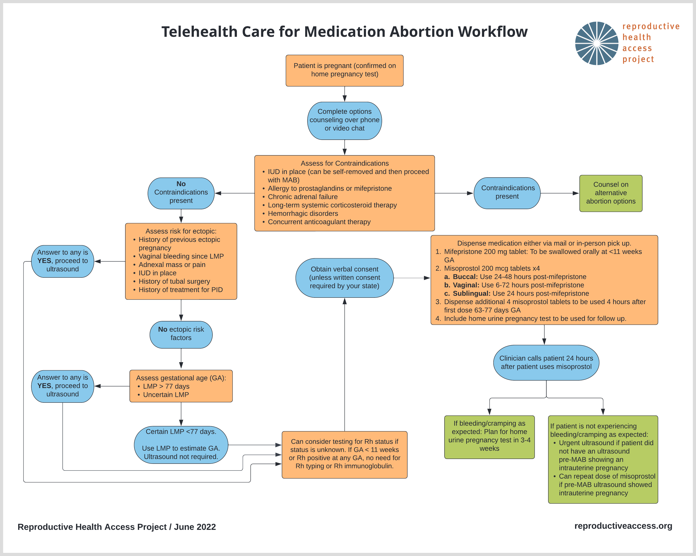
TELEHEALTH CARE FOR MEDICATION ABORTION WORKFLOW
Notes:
Note to Facilitator: option to use this to review steps of telehealth medication abortion
Sources:
https://www.reproductiveaccess.org/resource/telehealth-care-for-mab-workflow/

Slide 33

Ty: Additional Considerations
Clinician set-up
Screening for privacy
Screening for IPV and safety
Gender-affirming care
Image Source: https://genderphotos.vice.com/
Notes:
Additional considerations for telehealth & gender non-binary patients
Make sure you are set up for a telehealth appointment: natural or warm lighting, use simple backgrounds or blur filter for privacy, ensure you are in a quiet and private space with a reliable internet connection
Check with Ty first about whether they can talk freely and safely. This is very important for young people who may not feel safe to talk about reproductive health care at home around family, or people who may experience abuse/violence
Ask audience: What are some skills and strategies you can do to assess patient’s sense of privacy and confidentiality?
Ask Ty: Is it safe for you to speak over the phone/video? Is it safe for you to have a medication abortion at home?
For trans and non-binary people, abortion care can be an added difficult experience. Many clinics that provide abortion care use women-centered and women-facing language that can be highly marginalizing to these communities. Many trans and non-binary people have had traumatic or harmful experiences with health care providers. Being pregnant can also exacerbate gender dysphoria for some.
Trauma informed care is for everyone. It centers communication and care provision that is truly patient-centered, focuses on the patient’s autonomy and decision-making, and creates opportunities for a sense of control and empowerment.
Use gender inclusive language, ask for what names and pronouns people use, share your own, ask about how they refer to body parts before using your own language.
Ask: how else would you support Ty in these situations?
Note to facilitator: option to use these resources to expand upon safety screening/IPV support and gender-affirming abortion care
More resources on screening for safety and providing IPV support:
https://www.futureswithoutviolence.org/wp-content/uploads/Telehealth-Covid-19-IPV_Clinical-Pathway.pdf (page 2)
https://jamanetwork.com/journals/jama/fullarticle/2780630#jit210005b1
https://www.statnews.com/2020/07/17/rising-to-the-challenge-of-screening-for-intimate-partner-violence-during-covid-19/
Simon MA. Responding to Intimate Partner Violence During Telehealth Clinical Encounters. JAMA. 2021;325(22):2307–2308. doi:10.1001/jama.2021.1071
More resources on gender affirming abortion care
Optional 3 minute video of do’s and don’ts: https://www.innovating-education.org/2020/12/dos-and-donts/
Optional 4 minute video of language and impact: https://www.innovating-education.org/2020/12/language-and-impact/
Roosevelt L, Pietzmeier S, Reed R. Clinically and Culturally Competent Care for Transgender and Nonbinary People. The Journal of Perinatal & Neonatal Nursing. 2021; 35 (2): 142-149. doi: 10.1097/JPN.0000000000000560
https://transequality.org/issues/us-trans-survey
https://www.lgbtqiahealtheducation.org/resources/in/reproductive-health/
RHAP Gender-Afirming Reproductive Health in Primary Care Presentation: https://www.reproductiveaccess.org/resource/gender-affirming-reproductive-health-in-primary-care/
Image Source: https://genderphotos.vice.com/

Slide 34

PATIENT CASE:
Sonia
29 years old
She/Her pronouns
Wants a medication abortion
Unsure LMP
Image Source: Unsplash, https://unsplash.com/photos/YcX2e-X6aBE
Notes:
Let’s briefly walk through a situation where someone comes to you for a medication abortion, but is unsure of their LMP.
After abortion options counseling, you start to confirm Sonia’s medical history. You ask, “when was your last menstrual period?” Sonia is unsure and describes a range of time 10-12 weeks ago when she thinks she had her LMP.
Before jumping to requiring an ultrasound or additional tests/exams, we can try to first expand the screening questions we ask for determining gestational age to 3 questions:
When was your last menstrual period?
How many weeks pregnant do you think you are?
When do you believe you became pregnant?
These questions have demonstrated an increased sensitivity and accuracy, and reduces the number of people who screen eligible, but who are actually farther along.
You ask the next two questions to Sonia:
How many weeks pregnant do you think you are?
When do you believe you became pregnant?
She says that she thinks she’s 10 weeks pregnant and points out a day on the calendar when she thinks she became pregnant that corresponds closely to 10 weeks gestation.
You can confirm now that Sonia is 10 weeks pregnant and is eligible for medication abortion care. You move forward with the rest of the medication abortion counseling.
References:
Ralph LJ, Ehrenreich K, Barar R, et al. Accuracy of self-assessment of gestational duration among people seeking abortion [published online ahead of print, 2021 Dec 17]. Am J Obstet Gynecol. 2021;S0002-9378(21)02683-1. doi:10.1016/j.ajog.2021.11.1373
Image Source: Unsplash, https://unsplash.com/photos/YcX2e-X6aBE

Slide 35
Self-Managed Abortion / Self-Sourced Medication Abortion Terms
Self-Managed/Self-Sourced Abortion: an abortion that someone does outside of the medical system, without clinician supervision
  With medications, menstrual extraction, botanicals, herbs, other methods
Medication Abortion: an abortion with medicines provided by a clinician in-clinic or via telemedicine
No one should be criminalized for their abortion
Photo: RHAP
Notes:
We can’t talk about medication abortion and the landscape of abortion access in this country without talking about self-managed abortion (SMA).
SMA/SSA: Self-managed/self-sourced abortion is an abortion that someone does on their own outside of the [Western] medical system. It is often supported by friends, family members, partners, and/or community members. It can be with a medication regimen, traditional cultural means [like herbs, botanicals, etc], and at times it can be through unsafe means. No one should be criminalized for their abortion, regardless of method.
In-clinic medication abortion and telemedicine medication abortion are different than self-managed abortion even though the patient is taking the medicines at home.
SMA/SSA involves someone managing their own abortion without the supervision or monitoring of a health care provider.
Yet, people are often self-sourcing the same pills that a clinician would provide in-clinic or via telemedicine. What’s different is that someone who self-manages faces more legal risks, criminalization, and threats of harm compared to someone who seeks in-clinic care.
You can review RHAP’s resource, “Approach to Patients Undergoing Self-managed Medication Abortion” which shares common questions and concerns clinicians may hear about self-managed abortion (SMA) and how you can answer patient questions and share important information. Some highlights include: “How do I know the pills are real?”, “What’s the best way to use the pills?”, and “Can anyone tell that I used these pills?” Link: https://www.reproductiveaccess.org/resource/approach-to-patients-undergoing-self-managed-medication-abortion/
Note to Facilitator: Depending on your audience’s comfort level and familiarity with self-managed abortion/self-sourced medication abortion, you may choose to fully go through the section or tailor it to your audience’s needs. We believe talking about SMA/SSMA as part of the abortion care landscape in the US is crucial, especially given the likelihood of becoming more and more common as states continue to chip away at or outright ban abortion rights.
References:
Moseson H, Herold S, Filippa S, Barr-Walker J, Baum SE, Gerdts C. Self-managed abortion: A systematic scoping review. Best Pract Res Clin Obstet Gynaecol. 2020;63:87-110. doi:10.1016/j.bpobgyn.2019.08.002

Slide 36
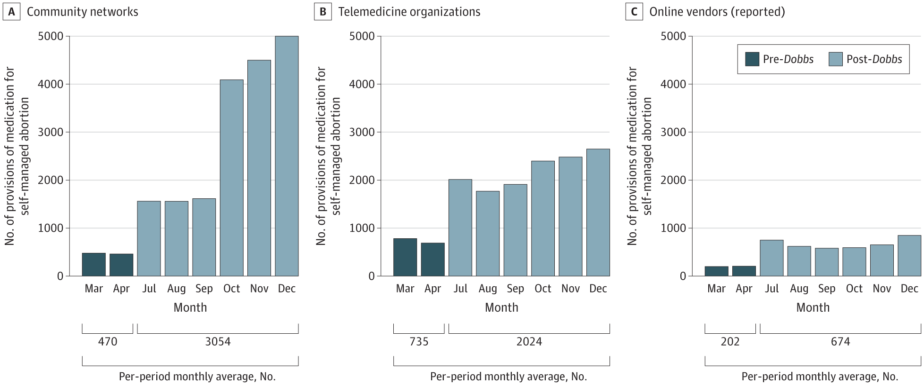
US Data & Demand for Self-Managed/Self-Sourced Abortion
Increase in demand for SMA during COVID-19 pandemic and after Dobbs
Higher prevalence among black women & Hispanic women compared to white women
Why SMA?
  State-based abortion restrictions
  Privacy, comfort, autonomy, convenience
  Avoid risks & harms of discrimination, etc.
Image Source: RHAP
Notes:
Let’s talk about data and demand for SMA/self-sourced abortion
There were increases in demand for self managed and self sourced abortion during the COVID-19 pandemic and after the Dobbs decision
Requests to the online medication abortion service Aid Access have doubled since the Dobb decision
Studies so far have only measured certain pathways to SMA, so demand is likely much higher
Prevalence of SMA is 3x higher among black women than white women, and elevated among Hispanic women indicating that they may face heightened barriers to accessing clinical care or prefer SMA/being outside the medical system due to experiences of stigma, discrimination, and structural racism
Why do people self-manage/self-source? The main push & pull factors are state-based restrictions, discrimination, systems of oppression:
Some people seek self-managed/self-sourced abortion due to financial and logistical barriers caused by state-based abortion restrictions that have made it difficult, time consuming, and expensive to access in-clinic care.
Some have this preference over in-clinic care due to privacy, comfort, autonomy, and convenience.
Communities who are over-policed, over-surveilled, over-incarcerated – like immigrants and low-income Black people may want to avoid in-clinic care due to fears of being targeted by law enforcement, being questioned for citizenship status, or stopped at checkpoints while in transit between towns.
People who experience health care discrimination, especially BIPOC and LGBTQ people may want to avoid in-clinic abortion care due to these experiences of persistent discrimination and harm in health care settings.
Some may be concerned with protesters at abortion clinics and the stigma associated with abortion in their communities
Women-centered places may not feel safe or comfortable for trans and gender-non-binary folks.
References:
Aiken ARA, Broussard K, Johnson DM, Padron E. Motivations and experiences of people seeking medication abortion online in the United States. Perspect Sex Reprod Health. 2018;50(4):157–163.
Aiken ARA, Starling JE, Gomperts R, Tec M, Scott JG, Aiken CE. Demand for self-managed online telemedicine abortion in the United States during the coronavirus disease 2019 (COVID-19) pandemic. Obstet Gynecol. 2020;136(4):835–837.
Ralph L, Foster DG, Raifman S. Prevalence of self-managed abortion among women of reproductive age in the United States. JAMA Netw Open. 2020;3(12):e2029245.
Aiken A, Starling J, Gomperts R. Factors associated with use of an online telemedicine service to access self-managed medical abortion in the US. JAMA Netw Open. 2021;4(5):e2111852.
Moseson H, Herold S, Filippa S, Barr-Walker J, Baum SE, Gerdts C. Self-managed abortion: a systematic scoping review. Best Pract Res Clin Obstet Gynaecol. 2020;63:87–110.
Paltrow L, Flavin J. Arrests of and forced interventions on pregnant women in the United States, 1973–2005: implications for women’s legal status and public health. J Health Polit Policy Law. 2013;38(2):299–343.
If/When/How. Supporting people who end pregnancies: necessary for reproductive justice. Available at: https://www.ifwhenhow.org/wp-content/uploads/2020/04/FINAL-Fact-Sheet-Self-Managed-Abortion-.pdf. Accessed February 11, 2021.
onovan MK. Self-managed medication abortion: expanding the available options for U.S. abortion care. Guttmacher Policy Rev. 2018;21:41–47.
https://reproductive-health-journal.biomedcentral.com/articles/10.1186/s12978-020-01016-4
https://www.thelancet.com/journals/langlo/article/PIIS2214-109X(21)00461-7/fulltext
https://www.who.int/reproductivehealth/self-care-interventions/medical-abortion/en/
Moseson H, Jayaweera R, Raifman S, et al. Self-managed medication abortion outcomes: results from a prospective pilot study. Reprod Health. 2020;17:164.
Moseson H, Bullard K, Cisternas C, Grosso B, Vera V, Gerdts C. Effectiveness of self-managed medication abortion between 13 and 24 weeks gestation: a retrospective review of case records from accompaniment groups in Argentina, Chile, and Ecuador. Contraception. 2020;102(2):91–98.
https://www.sciencedirect.com/science/article/pii/S2667193X22000175
https://jamanetwork.com/journals/jama/fullarticle/2816817&sa=D&source=docs&ust=1728497768653343&usg=AOvVaw2mX1ljRdgfbF3MxCUD0_Lg
https://www.ncbi.nlm.nih.gov/pmc/articles/PMC9989574/
https://www.guttmacher.org/2024/02/medication-abortion-within-and-outside-formal-us-health-care-system-what-you-need-know
https://www.news-medical.net/news/20240802/Since-fall-of-e28098Roee28099-self-managed-abortions-have-increased.aspx
https://www.npr.org/sections/shots-health-news/2024/07/31/nx-s1-5057588/abortion-mifepristone-jama-roe-v-wade
https://jamanetwork.com/journals/jama/fullarticle/2797883

Slide 37
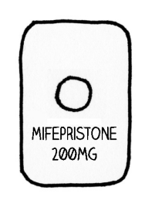
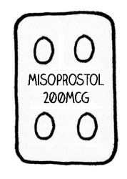
Safety of SMA
Self-sourcing abortion pills has made SMA much safer than ever before
Mife & Miso:
  Patients take the pills at home, manage their abortion, get follow-up if/when they need it
  Telemedicine is no less safe than in-clinic
Miso-only:
  With accurate information, miso is a safe & effective alternative to mife + miso
  Repeat doses may be necessary
  Accompaniment models
Image Source: RHAP “How to Use Abortion Pills” Factsheet
Photo: RHAP
Notes:
The ability to self-source medications for one’s abortion has made SMA so much safer than ever before.
The advent of MAB pills, the increase of information, and increase in the availability of pills and support networks has changed the safety of self-managed abortion dramatically since pre-Roe times.
Mife + Miso
We already know that abortion with mifepristone and misoprostol is safe and that patients can take the pills at home, manage their abortion, and get follow-up care in the rare cases they need it.
The FDA confirms that medication abortion’s “efficacy and safety have become well-established” and “serious complications have proven to be extremely rare.”
Studies on telemedicine abortion – as well as using services like Aid Access – demonstrate that telemedicine abortion is no less safe than in-clinic abortion
Miso-alone for SMA is a much more accessible and affordable option ($4) compared to using mifepristone outside of the health care setting, and one of the safest and most effective options for SMA.
WHO states that SMA with miso alone – with accurate information on how to use the pills – is very safe and effective. The risk of treatment failure with miso-only, requiring additional medications or a procedure, is about 10%.
Patients using misoprostol-only may experience more immediate, intense, and prolonged side effects than those using a combination of mife + miso.
Patients should take 3-4 doses of misoprostol. Repeat doses of misoprostol may be necessary to complete the abortion.
The SAFE study shows in global health practice, with accompaniment from community groups (like doulas, midwives, and other community experts but otherwise not necessarily trained health care experts), 95% of participants had complete abortions = 1.5% needed surgical intervention, 1% received antibiotics, 3% received other medications.
Studies of harm reduction approaches and accompaniment models have shown that when providers counsel on how to use misoprostol safely to induce an abortion and when to seek emergency care, country-wide abortion-related morbidity and mortality declines.
- A program called Iniciativas Sanitarias in Uruguay did just that. This led to the decriminalization of abortion in Uruguay.
Note to Facilitator: [If you as a facilitator are comfortable leading this conversation, consider introducing a discussion about herbal abortions below, consider asking some values clarification questions to help participants uncover their values and attitudes around herbal abortions]
Herbs, Botanicals, and other methods rooted in culture and ancestry
Non traditional methods, cultural methods passed down generations have not been studied for safety and efficacy to the extent of Western medicines, but that does not mean in itself they are unsafe
In a population based study estimating experience of SMA, researchers found that HERBS were the most common method people used to self-manage their abortion (38.4%) – while some had to go to the clinic to complete the abortion, there were very few complications.
The question of “are herbal abortions safe and effective” is not as clear cut as we think. Safety is a spectrum – what is safe for one person may not be the same for another. Data is lacking in this area, so the nuance is needed right now. A certified herbalist ad creator of the zine “Holistic Abortions, Grow Your Own Abortion” is a co-author in a CBPR Home Abortion Provider Study going on right now. Some initial findings:
There is no straightforward protocol, but different regimens they saw were: combining herbs with miso to help lower the dosage of miso necessary, herbs to manage heavy bleeding and severe pain, herbs being used to integrate spiritual, ritual, and cultural practices that the patient highly valued
An understanding that efficacy is not always the only priority – people wanted to try herbal-only abortions in the CBPR study despite being informed of a decreased possibility of completion and despite having access to other methods (i.e. telemedicine abortion)
We do NOT need to provide information on herbal abortions if it’s something we don’t understand or aren’t comfortable, but we should acknowledge and respect that forms of knowledge grow and exist outside of medicalized institutions and respecting patients’ expertise, knowledge, and desires is also part of bodily autonomy and reproductive justice
References
Instagram: @holistic.abortions
Holistic Abortions, Grow Your Abortion, the Holistic Abortion Guide
https://www.ansirh.org/research/research/seven-percent-us-women-will-self-manage-abortion-their-lifetimes
https://www.ibisreproductivehealth.org/publications/feminist-medication-abortion-accompaniment-101
U.S. Food and Drug Administration. Mifeprex medical review. Available at: https://www.accessdata.fda.gov/drugsatfda_docs/nda/2016/020687Orig1s020MedR.pdf. Published 2021. Accessed February 4, 2021.
World Health Organization. Medical management of abortion. Available at: https://apps.who.int/iris/bitstream/handle/10665/278968/9789241550406-eng.pdf?ua=1. Accessed January 26, 2021.
Raymond EG, Harrison MS, Weaver MA. Efficacy of misoprostol alone for first-trimester medical abortion: a systematic review. Obstet Gynecol. 2019;133(1):137–147.
Moseson H, Herold S, Filippa S, Barr-Walker J, Baum SE, Gerdts C. Self-managed abortion: a systematic scoping review. Best Pract Res Clin Obstet Gynaecol. 2020;63:87–110.
Donovan MK. Self-managed medication abortion: expanding the available options for U.S. abortion care. Guttmacher Policy Rev. 2018;21:41–47.
https://www.contraceptionjournal.org/article/S0010-7824(21)00091-3/fulltext
https://reproductive-health-journal.biomedcentral.com/articles/10.1186/s12978-020-01016-4
https://www.thelancet.com/journals/langlo/article/PIIS2214-109X(21)00461-7/fulltext
https://www.who.int/reproductivehealth/self-care-interventions/medical-abortion/en/
Moseson H, Jayaweera R, Raifman S, et al. Self-managed medication abortion outcomes: results from a prospective pilot study. Reprod Health. 2020;17:164.
Moseson H, Bullard K, Cisternas C, Grosso B, Vera V, Gerdts C. Effectiveness of self-managed medication abortion between 13 and 24 weeks gestation: a retrospective review of case records from accompaniment groups in Argentina, Chile, and Ecuador. Contraception. 2020;102(2):91–98.
https://www.sciencedirect.com/science/article/pii/S2667193X22000175
Aiken ARA, Digol I, Trussell J, Gomperts R. Self reported outcomes and adverse events after medical abortion through online telemedicine: population based study in the Republic of Ireland and Northern Ireland. BMJ. 2017;357:j2011.
Ralph L, Foster DG, Raifman S, et al. Prevalence of Self-Managed Abortion Among Women of Reproductive Age in the United States. JAMA Netw Open. 2020;3(12):e2029245. doi:10.1001/jamanetworkopen.2020.29245
https://societyfp.org/wp-content/uploads/2023/05/Medication-abortion-with-misoprostol-only_A-sample-protocol_2023_Final.pdf
Image Source: RHAP “How to Use Abortion Pills” Factsheet

Slide 38
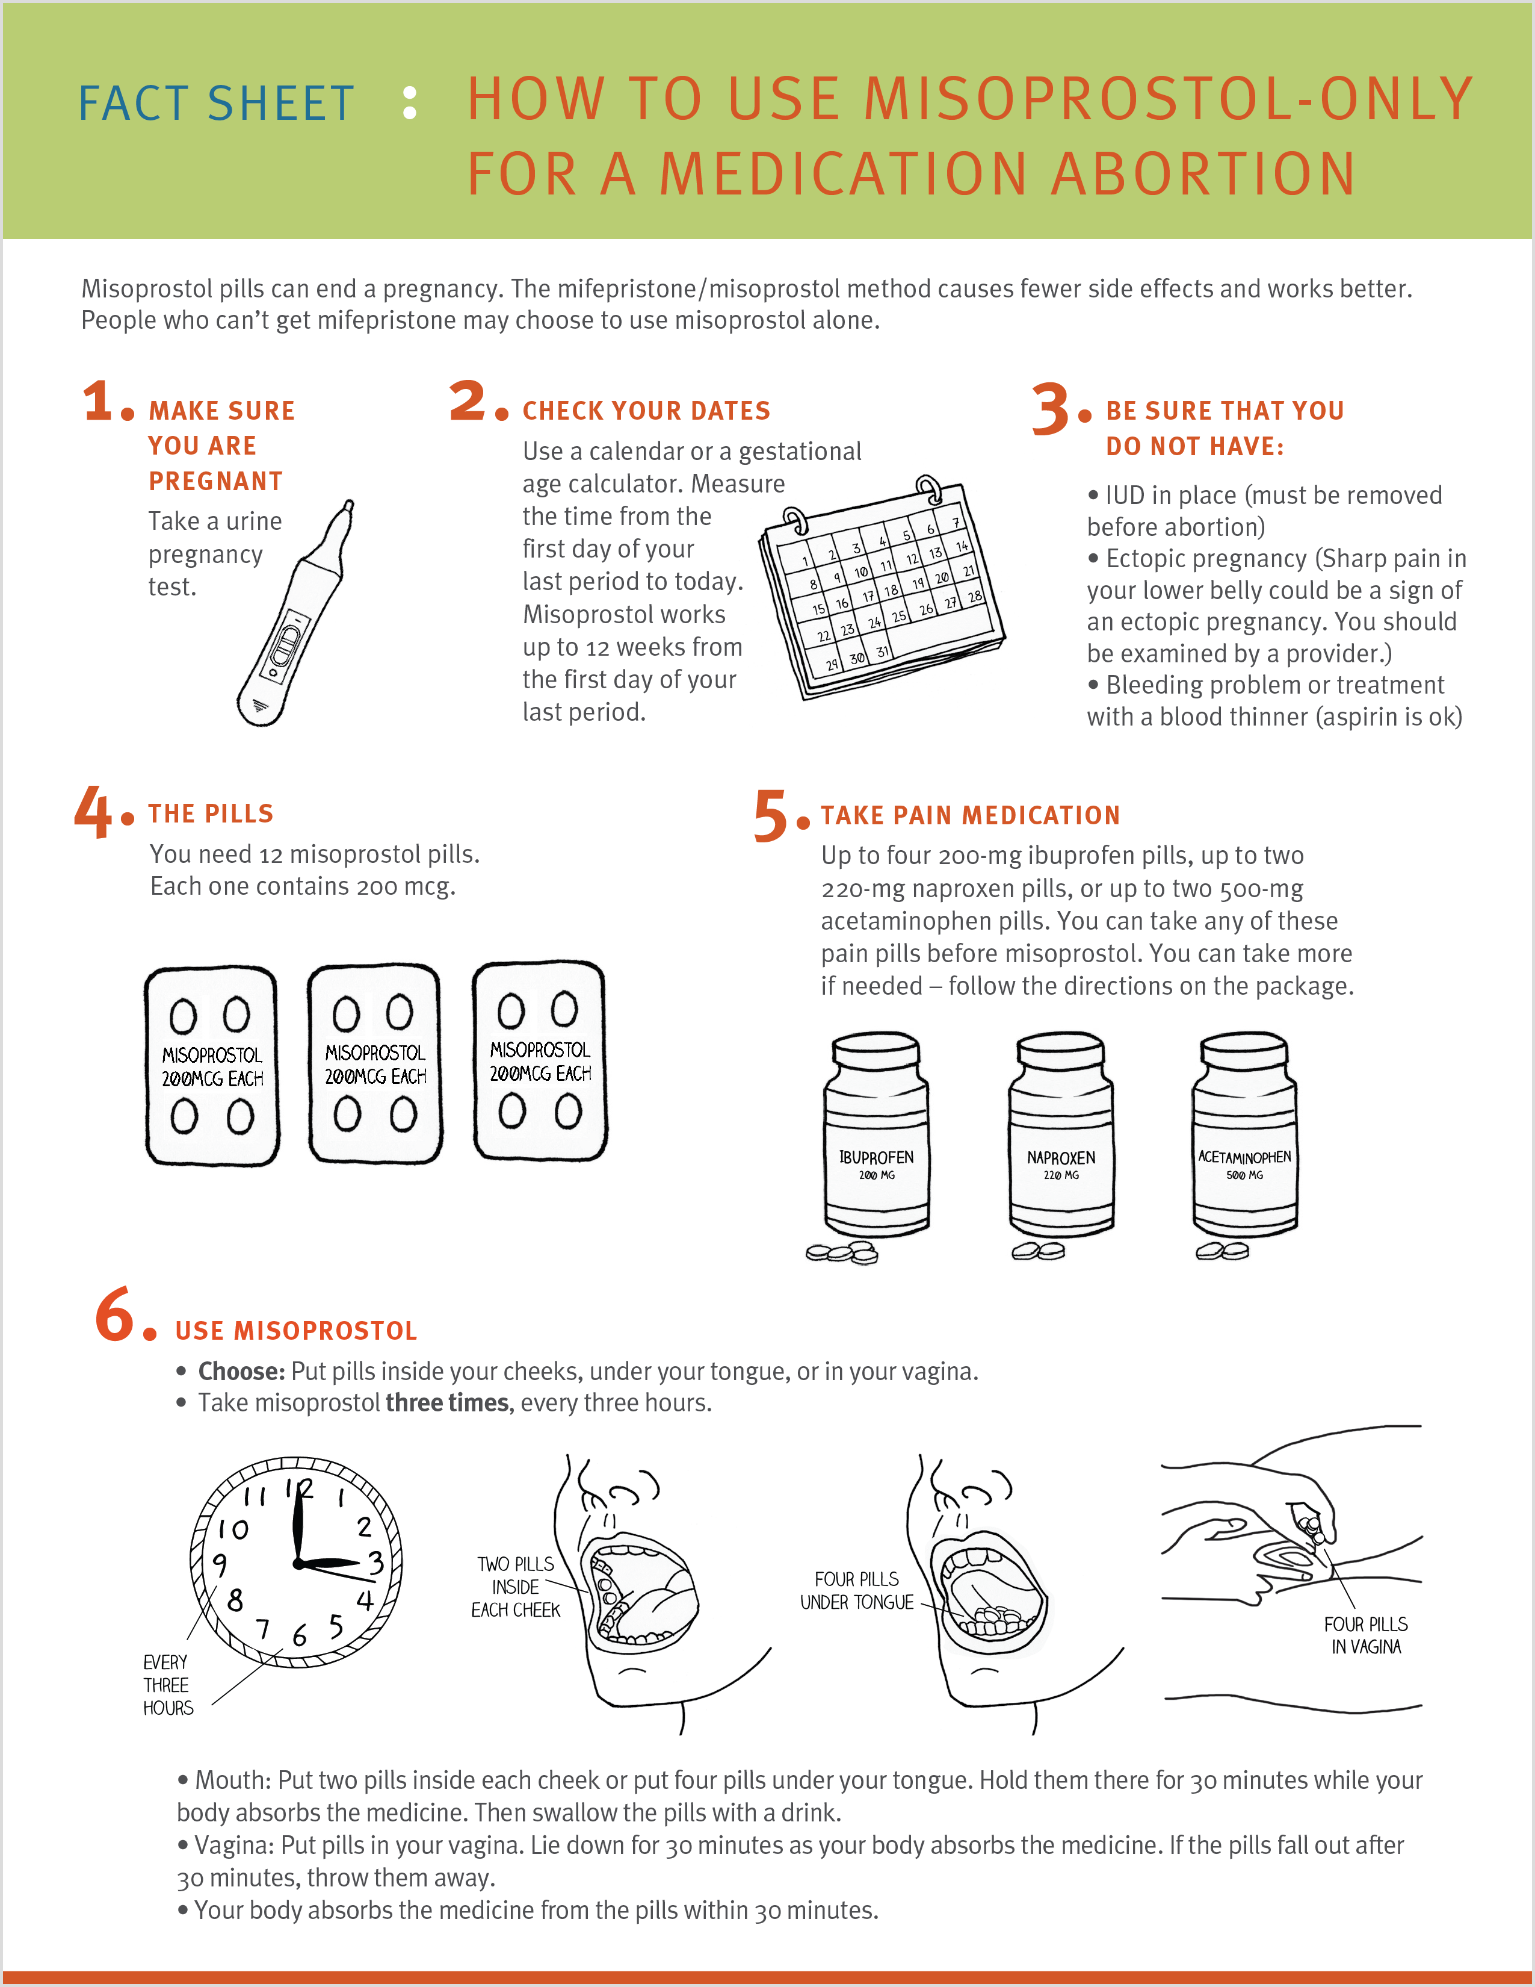
Misoprostol Alone Medication Abortion
Have 12 pills, 200 mcg each
Pain medicine before misoprostol
More than one dose might be needed: 3 doses, 3 hours apart
Image Source: RHAP, “How to Use Misoprostol-Only For a Medication Abortion” Factsheet
Notes:
All of you are able to counsel and provide information about having an abortion with mife and miso. So let’s walk through a miso-only abortion protocol so if you ever had to counsel a patient on the process, information, and when to seek medical attention, you have the knowledge to do so.
Walk through protocol (how to use miso-only for medication abortion factsheet or protocol)
Key contraindications: IUD in place, ectopic pregnancy, bleeding problem or treatment with blood thinner (aspirin is okay)
Patient needs 12 misoprostol pills, each with 200 mcg
Take pain medication before misoprostol (ibuprofen, naproxen, acetaminophen – follow instructions on package, take more if needed
Take misoprostol 3x every 3 hours – inside cheeks, under tongue, or in vagina
Buccal: put 2 pills inside each cheek or 4 pills under tongue. Hold there for 30 minutes. Swallow pills with a drink. Repeat 2 more times, every 3 hours.
Vaginal: put 4 pills inside vagina, lie down for 30 minutes, if pills fall out after 30 minutes throw them away. Repeat 2 more times, every 3 hours.
Things to expect: cramps and bleeding start within 7 hours, heavier than a period. Patient may see clots. May have gastrointestinal side effects (loose stools) and fever, chills.
When to contact clinician: no bleeding or only light spotting within 72 hours, soaking through 2 maxi pads per hour
Image Source/Resources:
https://www.reproductiveaccess.org/resource/mabfactsheet-miso/
References:
Raymond, E., Harrison, M, & Weaver, M. (2019). Efficacy of misoprostol alone for first-trimester medical abortion: A systematic review. Obstetrics & Gynecology, 133, 137-147.
https://www.ipas.org/clinical-update/english/recommendations-for-abortion-before-13-weeks-gestation/medical-abortion/misoprostol-only-recommended-regimen/
Ho PC, Blumenthal PD, Gemzell-Danielsson K, Gómez Ponce de León R, Mittal S, Tang OS. Misoprostol for the termination of pregnancy with a live fetus at 13 to 26 weeks. Int J Gynaecol Obstet. 2007 Dec;99 Suppl 2:S178-81
Moreno-Ruiz NL, Borgatta L, Yanow S, Kapp N, Wiebe ER, Winikoff B. Alternatives to mifepristone for early medical abortion. Int J Gynaecol Obstet. 2007 Mar;96(3):212-8
van Bogaert LJ, Sedibe TM. Efficacy of a single misoprostol regimen in the first and second trimester termination of pregnancy. J Obstet Gynaecol. 2007 Jul;27(5):510-2
Wiebe ER, Trouton KJ, Lima R. Misoprostol alone vs. methotrexate followed by misoprostol for early abortion. Int J Gynaecol Obstet. 2006 Dec;95(3):286-7
Blanchard K, Shochet T, Coyaji K, Thi Nhu Ngoc N, Winikoff B. Misoprostol alone for early abortion: an evaluation of seven potential regimens. Contraception. Aug 2005;72(2):91-97.
Blanchard K, Winikoff B, Ellertson C. Misoprostol used alone for the termination of early pregnancy. A review of the evidence. Contraception. Apr 1999;59(4):209-217.
Jain JK, Dutton C, Harwood B, Meckstroth KR, Mishell DR, Jr. A prospective randomized, double-blinded, placebo-controlled trial comparing mifepristone and vaginal misoprostol to vaginal misoprostol alone for elective termination of early pregnancy. Hum Reprod. Jun 2002;17(6):1477-1482.

Slide 39

SMA and Criminalization
Part of a larger web of criminalization
Cases of criminalization always on patients, reported by health care workers
  Health care workers not criminalized despite clear HIPAA violations
Laws often misapplied by police and prosecutors
Criminalization (or fear of) is the main barrier that prevents people from safely managing their abortion
Image Source: https://www.interruptingcriminalization.com/decriminalize-abortion
Photo: RHAP
Notes:
Restrictions on abortion and reproductive health care, including criminalization of SMA, is part of a larger web of criminalization and punishment of poverty, drug use, parenting, and abortion. Members of communities most marginalized are surveilled and criminalized in their communities before, after, and during pregnancy. Criminalization of reproductive autonomy is rooted in a long history of white supremacy in legal, medical, and social systems – deeming certain people unfit and undeserving of basic health care and reproductive autonomy.
Some examples to highlight:
Medical providers have historically collaborated with law enforcement to police, criminalize, and commit disabled people, people with unmet mental health/housing needs, and undocumented immigrants/migrants. Health care settings are becoming sites of surveillance and policing rather than places for health and well-being, perpetuating the distrust communities may have of the medical system.
SB8 and criminalization of abortion provision
Reporting of black and brown people to ICE
Police presence in health care and other care spaces
Medically unnecessary drug and alcohol testing for benefits, health care, etc
If/When/How: Lawyering for Reproductive Justice has seen over the past years an appalling misuse of laws and policies to criminalize people during pregnancy, including SMA – primarily people of color and people living in poverty. State laws, some even not specific to pregnancy are being misapplied by police and prosecutors to punish people who self manage, creating stigma and fear. They misuse pre-Roe laws on the books banning SMA, pre-Roe laws criminalizing abortion generally, drug laws, fetal harm laws, etc. Additionally, cases of criminalization are always blaming and harming patients, although health care workers are often reporting these patients -- violating HIPAA privacy laws and not getting punished for doing so.
Criminalization and fear of criminalization is the largest barrier that prevents people from safely managing their abortion with support. And, ACOG finds that fear of prosecution increases the risk of negative health outcomes by deterring those who self manage from seeking care for complications.
References:
https://www.interruptingcriminalization.com/decriminalize-abortion
Image Source: https://www.interruptingcriminalization.com/decriminalize-abortion

Slide 40

How can we as clinicians support the full range of safe abortion options, including SMA?
Image Source: Abortiononourownterms.org
Notes:
So what do you think are ways we as clinicians can support the full range of safe abortion options, including SMA?
Optional Reflection Questions
Is abortion treated as a human right in your practice setting? Why or why not?
What are the policies and protocols in your practice regarding involving patients in the criminal justice system? How might they affect the lives of your patients?
How can you support patients who managed their own abortions in your practice?
Image Source: Abortiononourownterms.org

Slide 41
Supporting SMA as clinicians
No mandatory reporting – use your discretion
Provide INFORMATION and COUNSELING about abortion options, including SMA if they prefer
Post abortion care mimics clinical presentation of EPL
Educate colleagues using values clarification
Review written policies and create policies
Get mandatory reporting & HIPAA/privacy trainings for your institution
Speak about SMA with compassion, respect
https://www.reprolegalhelpline.org/sma-contact-the-helpline/
  (844-868-2812)
Notes:
Clinicians and other health care personnel typically do not have mandatory reporting requirements for SMA
Reporting may be a HIPAA violation and violation of patient privacy and confidentiality laws
Clinicians have a lot of discretion and power in reporting
Know the mandatory reporting laws in your state
Be judicious in what you record in the EMR
Regardless of our personal beliefs, we have responsibilities as health care providers:
Provide pregnancy options counseling, which includes information about abortion
Refer patients to sources of care if you cannot provide it at your clinic
Uphold core values: patient autonomy, patients’ health care needs above our personal beliefs
Provide information on safe self-management if that is what they prefer: what are the medications, how to take them, what to expect, when/where to seek help if you need it = all of us are allowed to provide SMA information
Support people with the information they need after an SMA, provide follow-up care for people who want to confirm their completed abortion, and support them if they come in with heavy bleeding, pain, fevers, or complications – which we know from studies is rare. These are the same symptoms and potential complications of miscarriage care.
Post abortion care mimics the clinical presentation of a miscarriage. There is no reason to assume or record self-management in the patient’s chart. A patient who is bleeding with a positive pregnancy test and non-viable fetus should be treated like anyone pregnant and bleeding.
EDUCATE colleagues about SMA – values clarification is a great place to start.
Review written policies on mandatory reporting: are there ways to change the policy so that it does not go beyond what is required by the state and upholds patient privacy and autonomy?
Support your institution with HIPAA and mandatory reporting trainings (If/When/How can help with mandatory reporting trainings)
Speak about SMA with compassion and respect: Judgment or discouragement from someone in the medical profession may increase feelings of shame and deter people from seeking medical care in the rare event of a post-self-managed abortion complication.
This is not legal advice, this is information we have learned thus far. If you want more information about legal issues, mandatory reporting, your state laws and requirements affecting SMA, access the repro legal helpline at If/When/How – they have begun an extensive program to support clinicians and communities with legal information (and counsel if needed) they need to self manage their abortions safely and with dignity.
References
https://www.innovating-education.org/course/when-abortion-is-not-available/
If/When/How Presentation with Teach
If/When/How. Self-Managed Abortion and the Law. What health care providers need to know.
If/When/How Repro Legal Helpline: http://www.reprolegalhelpline.org/

Slide 42

Methotrexate and misoprostol medication abortion
Notes:
Methotrexate IM + Misoprostol vaginally for medication abortion
In countries where mifepristone is widely available, methotrexate is used infrequently.
Methotrexate is less effective – and the process is a little longer and less predictable.
We have protocols approved with Methotrexate only up to 49 days (compared with the 77-day limit for mifepristone).
Methotrexate abortions usually take longer -- may require more visits, additional doses of misoprostol.
However, methotrexate has some advantages:
-It’s inexpensive compared to mifepristone
-It’s easy to purchase (no special process like FDA REMS or patient agreement)
-It treats early ectopic pregnancy

Slide 43
Your turn!
Case Studies
Notes:
Optional Activity (20-30 minutes)
Before or instead of talking about barriers to providing medication abortion in primary care and strategies to overcome them, divide participants into small groups or breakout rooms to go through and discuss the two case studies in the Participant Case Study Guide. You can also walk through the case studies as 1 large group asking on participants to read sections and answer the discussion questions. There are 2 case studies.

Slide 44
What barriers do you anticipate if you were to try to provide medication abortion care in your office?
Photo: RHAP
Notes:
Note to facilitator: This discussion may not be appropriate in states that are highly restrictive toward abortion care. Consider your audience before discussing this part of the presentation.
If you include this part of the presentation, you can offer the audience to share their ideas first, or you can go through issues to think about on the next slide and ask the audience for other concerns and barriers they are thinking about.

Slide 45

Issues to think about
Special considerations if you receive federal funding
Laws regulating abortion in your state
Organize a planning committee
Staff support
Pharmacy
Clinical policies + procedures
Billing and reimbursement
Professional liability insurance
Notes:
Here are some of the big picture issues to think about. We’re going to briefly summarize them, but please visit the RHAP website which contains a lot of tools and resources that can help you with these issues. RHAP staff can provide technical assistance to any clinician or organization needing help to integrate abortion care. Reach out to program@reproductiveaccess.org.
[Drop links in the chat]
The main resource to review is this toolkit which goes through many ideas on getting started with medication abortion in primary care. https://www.reproductiveaccess.org/resource/toolkit-medication-abortion/
1. If you receive federal funding, you can still provide abortion care, but you’ll have key things to consider and navigate to ensure in your accounting that any funding that goes toward providing abortion services is not federal funds or otherwise restricted funds. RHAP can help you navigate this.
2. Depending upon your state, this could be a complicated discussion. RHAP has done some preliminary work to identify state abortion laws in Network Cluster states. Please make sure to connect with RHAP and your local cluster to understand if any laws or policies affect abortion care in your state. Guttmacher Institute has excellent resources on up to date information about state laws and policies. RHAP is also working with a lawyer to help understand and draft guidances on specific legal questions that come up. If you do have any legal questions specifically around providing medication abortion in an FQHC, do reach out to RHAP at program@reproductiveaccess.org
3. Start by identifying other clinicians, administrators, and staff who might be allies and champions in introducing abortion services. Form a planning committee that can meet regularly to discuss tasks, timeline, barriers, and potential solutions. It’s helpful for this team to be multidisciplinary and to include an administrator.
4. Starting conversations with staff around providing abortion care is critical. Include all staff at all levels. Many start with Values Clarification exercises to help process feelings. https://www.reproductiveaccess.org/resource/values-clarification-workshop/. Some places do a staff and patient attitude survey: Patient attitude survey example: https://www.reproductiveaccess.org/resource/patient-attitude-survey/. Staff attitude survey example: https://www.reproductiveaccess.org/resource/staff-attitude-survey/
5. Your pharmacy or someone in your organization needs to sign up with a distributor to dispense the mifepristone. There are two distributors: GenBioPro (generic) and Danco (branded, Mifeprex). Here is the guide on signing up with GenBioPro: https://genbiopro.com/ordering/. Here is a step by step guide on signing up with Danco: https://www.reproductiveaccess.org/resource/order-mifepristone/.
There is a provider agreement to sign and account setup for to be filled out. Also paperwork for patients to sign. That information for GenBioPro can be found here: https://genbiopro.com/wp-content/uploads/2019/05/GenBioPro-Prescriber-Agreement-Form.pdf. And the patient agreement form can be found here: https://genbiopro.com/wp-content/uploads/2019/05/GenBioPro-Patient-Agreement.pdf.
That information for Danco can be found here: http://www.earlyoptionpill.com/wp-content/uploads/2016/02/Prescriber-Agreement-Form-March2016-2.pdf. And here: https://www.earlyoptionpill.com/for-health-professionals/ordering-mifeprex/
6. RHAP has sample policies, protocols and procedures you can adjust. Policy + Procedure: https://www.reproductiveaccess.org/resource/medication-abortion-policy-procedure/. Clinical Protocol: https://www.reproductiveaccess.org/resource/medication-abortion-protocol/
7. Reimbursement varies by state and insurance plan. Only a few states provide Medicaid reimbursement of abortion. https://www.reproductiveaccess.org/resource/medication-abortion-coding/. It is possible to provide abortion in health centers that receive federal funding, including FQHCs. Special care needs to be taken to segregate costs/visits so that no federal dollars are spent on abortion care. But it is possible! RHAP can help. See this billing guide: https://www.reproductiveaccess.org/resource/abortion-administrative-guide/ and contact RHAP for more support.
8. Definitely check to make sure your professional liability insurance/malpractice will cover medication abortion. If you work in a federally qualified health center, you will likely have to get additional insurance to cover medication abortion care. Lots of FQHCs have gap coverage in place for services like L&D and hospital care -- it’s possible to add abortion care to gap coverage too.
Additional Resources:
https://familymedicine.uw.edu/accessdelivered/
Image Source: Created by Adrien Coquet from the Noun Project

Slide 46
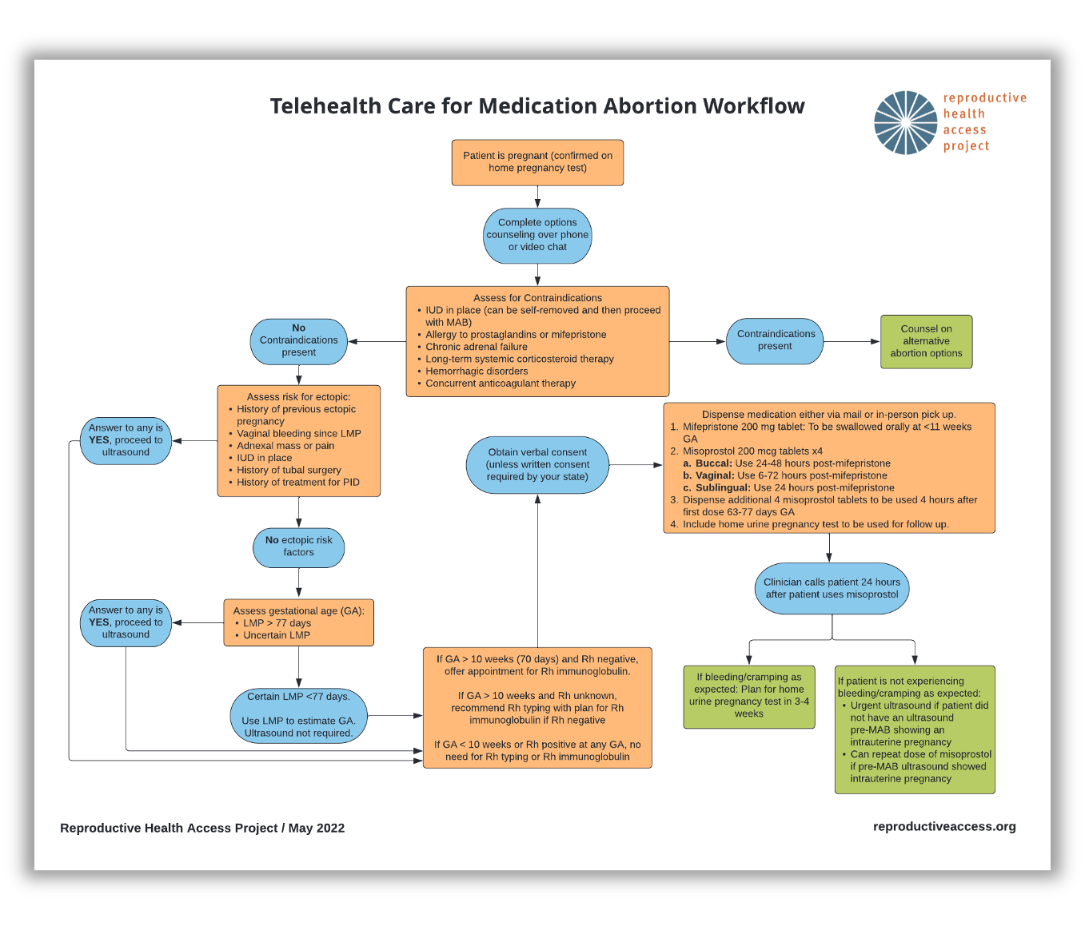

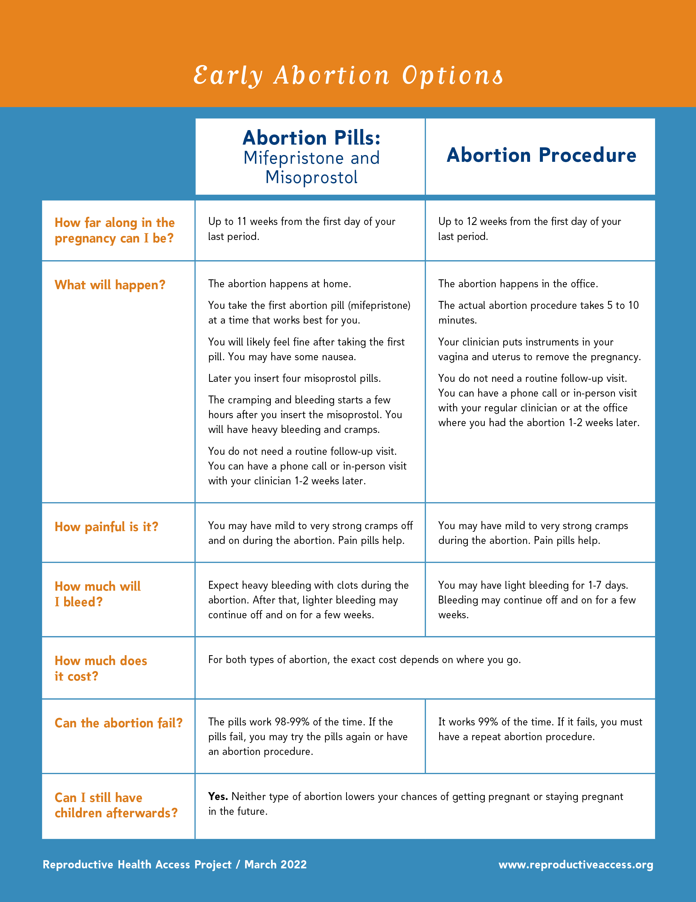
RESOURCES.
Telehealth Care for Medication Abortion Workflow
Early Abortion Options
Medication Abortion FAQ
Protocol for Medication Abortion Using Mifepristone and Misoprostol
Coding for Medication Abortion using Mifepristone and Misoprostol
Sam’s Medication Abortion Zine
Algorithm for Phone Triage of Bleeding with Medication Abortion
Notes:
https://www.reproductiveaccess.org/resource/telehealth-care-for-mab-workflow/
https://www.reproductiveaccess.org/resource/early-abortion-options/
https://www.reproductiveaccess.org/resource/medication-abortion-faqs/
https://www.reproductiveaccess.org/resource/medication-abortion-protocol/
https://www.reproductiveaccess.org/resource/medication-abortion-coding/
https://www.reproductiveaccess.org/resource/sams-medication-abortion-zine/
https://www.reproductiveaccess.org/resource/algorithm-phone-triage-bleeding-medication-abortion/

Slide 47
REFERENCES.
Abortion care guideline. Geneva: World Health Organization; 2022. Licence: CC BY-NC-SA 3.0 IGO.
Access Delivered A Toolkit for Providers Offering Medication Abortion. Familymedicine.uw.edu. https://familymedicine.uw.edu/accessdelivered/. Published 2022. Accessed May 19, 2022.
Aiken ARA, Broussard K, Johnson DM, Padron E. Motivations and experiences of people seeking medication abortion online in the United States. Perspect Sex Reprod Health. 2018;50(4):157–163.
Aiken ARA, Digol I, Trussell J, Gomperts R. Self reported outcomes and adverse events after medical abortion through online telemedicine: population based study in the Republic of Ireland and Northern Ireland. BMJ. 2017;357:j2011.
Aiken A, Romanova E, Morber J, Gomperts R. Safety and effectiveness of self-managed medication abortion provided using online telemedicine in the United States: A population based study. The Lancet Regional Health - Americas. 2022:100200. doi:10.1016/j.lana.2022.100200
Aiken ARA, Starling JE, Gomperts R, Tec M, Scott JG, Aiken CE. Demand for self-managed online telemedicine abortion in the United States during the coronavirus disease 2019 (COVID-19) pandemic. Obstet Gynecol. 2020;136(4):835–837.
Aiken A, Starling J, Gomperts R. Factors associated with use of an online telemedicine service to access self-managed medical abortion in the US. JAMA Netw Open. 2021;4(5):e2111852.
All-Options: All-options pregnancy support. All-options.org. https://www.all-options.org/. Published 2022. Accessed May 19, 2022.
Anderson E, Salganicoff A, Sobel L. State Restrictions on Telehealth Abortion. KFF. https://www.kff.org/womens-health-policy/slide/state-restrictions-on-telehealth-abortion/. Published 2021. Accessed May 19, 2022.
An Overview of Abortion Laws. Guttmacher Institute. https://www.guttmacher.org/state-policy/explore/overview-abortion-laws. Published 2022. Accessed May 19, 2022.
Baird D. Mode of action of medical methods of abortion. JAMWA. 2000; 35(3): S121-126.
Beverly W, Dzuba IG, Chong E, et al. Extending Outpatient Medical Abortion Services Through 70 Days of Gestational Age. Obstetrics & Gynecology. 2012;120(5):1070-1076. doi:10.1097/AOG.0b013e31826c315f.
Blanchard K, Shochet T, Coyaji K, Thi Nhu Ngoc N, Winikoff B. Misoprostol alone for early abortion: an evaluation of seven potential regimens. Contraception. Aug 2005;72(2):91-97.
Blanchard K, Winikoff B, Ellertson C. Misoprostol used alone for the termination of early pregnancy. A review of the evidence. Contraception. Apr 1999;59(4):209-217.
Bracken, H., N.T.N. Ngoc, E. Schaff, K. Coyaji, S. Ambardekar, E. Westheimer, B. Winikoff. Mifepristone Followed in 24 Hours to 48 Hours by Misoprostol for Late First-Trimester Abortion. Obstetrics and Gynecology (Apr 2007), 109 pp.895-901.
Cansino C, Lichtenberg ES, Perriera LK, et al. Do women want to talk about birth control at the time of a first-trimester abortion? Contraception. 2018 Dec;98(6):535-540. doi: 10.1016/j.contraception.2018.08.005.
Castillo P, Sanhueza P, Hernandez EML, Bousieguez M, Dzuba I. Does a repeat dose of 800mcg misoprostol following mifepristone improve outcomes in the later first trimester? A retrospective chart review in Mexico City. Paper presented at: National Abortion Federation Annual Meeting; April 22, 2017; Montreal, Quebec.
Chong E, Shochet T, Raymond E et al. Expansion of a direct-to-patient telemedicine abortion service in the United States and experience during the COVID-19 pandemic. Contraception. 2021;104(1):43-48. doi:10.1016/j.contraception.2021.03.019
Contraceptive Pearls: Post Abortion Contraception. Reproductiveaccess. https://www.reproductiveaccess.org/resource/contraceptive-pearls-post-abortion-contraception/. Published 2021. Accessed May 19, 2022.
Coyaji,K., U. Krishna, S. Ambardekar, H. Bracken, V. Raote, A. Mandlekar, B. Winikoff. Are two doses of misoprostol after mifepristone for early abortion better than one? British Journal of Obstetrics and Gynaecology, (Mar 2007), 114 (3), pp. 271–278.
Creinin MD, Fox MC, Teal S, Chen A, Schaff EA, Meyn LA: MOD Study Trial Group: A randomized comparison of misoprostol 6 to 8 hours versus 24 hours after mifepristone for abortion. Obstet. Gynecol. 2004 103(5 Pt. 1): 851-859
Curtis KM, Jatlaoui TC, Tepper NK, et al. U.S. selected practice recommendations for contraceptive use, 2016. MMWR Recomm Rep. 2016;65(4):1.
Denny C. How to start birth control after an abortion. Bedsider website. August 2019. Accessed May 2021. https://www.bedsider.org/features/1319-how-to-start-birth-control-after-an-abortion.
Diaz-Tello F, Grant E, Lin C et al. Abortion Decriminalization Is Part Of The Larger Struggle Against Policing And Criminalization: How Our Movements Can Organize In Solidarity With Each Other. Interrupting Criminalization; 2022. https://static1.squarespace.com/static/5ee39ec764dbd7179cf1243c/t/6194235775f2a0615ea53cde/1637098383973/Decriminalize+Abortion. Accessed May 19, 2022.
Donovan MK. Self-managed medication abortion: expanding the available options for U.S. abortion care. Guttmacher Policy Rev. 2018;21:41–47.
Do's and Dont's. Bixby Center for Global Reproductive Health; 2021. https://www.innovating-education.org/2020/12/dos-and-donts/. Accessed April 21, 2022.
Early Abortion Options. Reproductive Health Access Project; 2022. https://www.reproductiveaccess.org/resource/early-abortion-options/. Accessed May 19, 2022.
Feminist Medication Abortion Accompaniment 101. Ibis Reproductive Health; 2021. https://www.ibisreproductivehealth.org/sites/default/files/files/publications/Abortion%20accompaniment%20101.pdf. Accessed May 19, 2022.
Finer LB and Zolna MR, Declines in Unintended Pregnancy in the United States, 2008–2011; The New England Journal of Medicine 2016, 374(9):843-52.
Guest J, Chien P, Thomson M, Kosseim ML. Randomised controlled trial comparing efficacy of same day administration of mifepristone and misoprostol for termination of pregnancy with the standard 36- to 48-hour protocol. Bjog. Oct 2005;112(10):1457.
Herrmann WL et al. Effects of the antiprogesterone RU 486 in early pregnancy and during the menstrual cycle. Future aspects in contraception. 1984 Ch. 22:249-70.
Ho PC, Blumenthal PD, Gemzell-Danielsson K, Gómez Ponce de León R, Mittal S, Tang OS. Misoprostol for the termination of pregnancy with a live fetus at 13 to 26 weeks. Int J Gynaecol Obstet. 2007 Dec;99 Suppl 2:S178-81
Holistic Abortions [@holistic.abortions]. (n.d.). Posts [Instagram profile]. Retrieved May 19, 2022, from https://www.instagram.com/holistic.abortions
If/When/How. Self-Managed Abortion and the Law. What health care providers need to know.
If/When/How. Supporting people who end pregnancies: necessary for reproductive justice. Available at: https://www.ifwhenhow.org/wp-content/uploads/2020/04/FINAL-Fact-Sheet-Self-Managed-Abortion-.pdf. Accessed February 11, 2021.
Indications For Sonography For Medication Abortion. Reproductive Health Access Project; 2019. https://www.reproductiveaccess.org/resource/indications-sonography-medication-abortion/. Accessed May 19, 2022.
Induced Abortion in the United States, Sept 2019 Fact Sheet, https://www.guttmacher.org/fact-sheet/induced-abortion-united-states
Jain JK, Dutton C, Harwood B, Meckstroth KR, Mishell DR, Jr. A prospective randomized, double-blinded, placebo-controlled trial comparing mifepristone and vaginal misoprostol to vaginal misoprostol alone for elective termination of early pregnancy. Hum Reprod. Jun 2002;17(6):1477-1482.
Jain J, Dutton C, Nicosia A, et al. Pharmacokinetics, ovulation suppression and return to ovulation following a lower dose subcutaneous formulation of Depo-Provera. Contraception. 2004;70(1):11.
Jerman J, Jones R, Onda T. Characteristics of U.S. Abortion Patients in 2014 and Changes Since 2008. Guttmacher Institute. https://www.guttmacher.org/report/characteristics-us-abortion-patients-2014. Published 2016. Accessed May 18, 2022.
Jones R, Jerman J. Abortion Incidence and Service Availability In the United States, 2014. Perspect Sex Reprod Health. 2017;49(1). doi:10.1363/psrh.12015
Jones R, Jerman J. Population Group Abortion Rates and Lifetime Incidence of Abortion: United States, 2008–2014. Am J Public Health. 2017;107(12):1904-1909. doi:10.2105/ajph.2017.304042
Jones R, Nash E, Cross L, Philbin J, Kristein M. Medication Abortion Now Accounts for More Than Half of All US Abortions. Guttmacher Institute. https://www.guttmacher.org/article/2022/02/medication-abortion-now-accounts-more-half-all-us-abortions. Published 2022. Accessed May 18, 2022.
Kapp N, Eckersberger E, Lavelanet A, Rodriguez MI. Medical abortion in the late first trimester: a systematic review. Contraception. 2019;99(2):77-86. doi: 10.1016/j.contraception.2018.11.002.
Language and Impact. A project of the Bixby Center for Global Reproductive Health; 2021. https://www.innovating-education.org/2020/12/language-and-impact/. Accessed April 21, 2022.
Learning Resources - Reproductive Health. lgbtqiahealtheducation.org. https://www.lgbtqiahealtheducation.org/resources/in/reproductive-health/. Published 2022. Accessed May 19, 2022.
Li C-L, Chen D-J, Song L-P, et al. Effectiveness and Safety of Lower Doses of Mifepristone Combined With Misoprostol of the Termination of Ultra-Early Pregnancy: A Dose-Ranging Randomized Controlled Trial. Reproductive Sciences. 2014;22(6):706-711.
Luo E, Golen T, Kimball A. Rising to the challenge of screening for intimate partner violence during Covid-19. STAT. https://www.statnews.com/2020/07/17/rising-to-the-challenge-of-screening-for-intimate-partner-violence-during-covid-19/. Published 2020. Accessed May 19, 2022.
Notes:
Abortion care guideline. Geneva: World Health Organization; 2022. Licence: CC BY-NC-SA 3.0 IGO.
Access Delivered A Toolkit for Providers Offering Medication Abortion. Familymedicine.uw.edu. https://familymedicine.uw.edu/accessdelivered/. Published 2022. Accessed May 19, 2022.
Aiken ARA, Broussard K, Johnson DM, Padron E. Motivations and experiences of people seeking medication abortion online in the United States. Perspect Sex Reprod Health. 2018;50(4):157–163.
Aiken ARA, Digol I, Trussell J, Gomperts R. Self reported outcomes and adverse events after medical abortion through online telemedicine: population based study in the Republic of Ireland and Northern Ireland. BMJ. 2017;357:j2011.
Aiken A, Romanova E, Morber J, Gomperts R. Safety and effectiveness of self-managed medication abortion provided using online telemedicine in the United States: A population based study. The Lancet Regional Health - Americas. 2022:100200. doi:10.1016/j.lana.2022.100200
Aiken ARA, Starling JE, Gomperts R, Tec M, Scott JG, Aiken CE. Demand for self-managed online telemedicine abortion in the United States during the coronavirus disease 2019 (COVID-19) pandemic. Obstet Gynecol. 2020;136(4):835–837.
Aiken A, Starling J, Gomperts R. Factors associated with use of an online telemedicine service to access self-managed medical abortion in the US. JAMA Netw Open. 2021;4(5):e2111852.
All-Options: All-options pregnancy support. All-options.org. https://www.all-options.org/. Published 2022. Accessed May 19, 2022.
Anderson E, Salganicoff A, Sobel L. State Restrictions on Telehealth Abortion. KFF. https://www.kff.org/womens-health-policy/slide/state-restrictions-on-telehealth-abortion/. Published 2021. Accessed May 19, 2022.
An Overview of Abortion Laws. Guttmacher Institute. https://www.guttmacher.org/state-policy/explore/overview-abortion-laws. Published 2022. Accessed May 19, 2022.
Baird D. Mode of action of medical methods of abortion. JAMWA. 2000; 35(3): S121-126.
Beverly W, Dzuba IG, Chong E, et al. Extending Outpatient Medical Abortion Services Through 70 Days of Gestational Age. Obstetrics & Gynecology. 2012;120(5):1070-1076. doi:10.1097/AOG.0b013e31826c315f.
Blanchard K, Shochet T, Coyaji K, Thi Nhu Ngoc N, Winikoff B. Misoprostol alone for early abortion: an evaluation of seven potential regimens. Contraception. Aug 2005;72(2):91-97.
Blanchard K, Winikoff B, Ellertson C. Misoprostol used alone for the termination of early pregnancy. A review of the evidence. Contraception. Apr 1999;59(4):209-217.
Bracken, H., N.T.N. Ngoc, E. Schaff, K. Coyaji, S. Ambardekar, E. Westheimer, B. Winikoff. Mifepristone Followed in 24 Hours to 48 Hours by Misoprostol for Late First-Trimester Abortion. Obstetrics and Gynecology (Apr 2007), 109 pp.895-901.
Cansino C, Lichtenberg ES, Perriera LK, et al. Do women want to talk about birth control at the time of a first-trimester abortion? Contraception. 2018 Dec;98(6):535-540. doi: 10.1016/j.contraception.2018.08.005.
Castillo P, Sanhueza P, Hernandez EML, Bousieguez M, Dzuba I. Does a repeat dose of 800mcg misoprostol following mifepristone improve outcomes in the later first trimester? A retrospective chart review in Mexico City. Paper presented at: National Abortion Federation Annual Meeting; April 22, 2017; Montreal, Quebec.
Chong E, Shochet T, Raymond E et al. Expansion of a direct-to-patient telemedicine abortion service in the United States and experience during the COVID-19 pandemic. Contraception. 2021;104(1):43-48. doi:10.1016/j.contraception.2021.03.019
Contraceptive Pearls: Post Abortion Contraception. Reproductiveaccess. https://www.reproductiveaccess.org/resource/contraceptive-pearls-post-abortion-contraception/. Published 2021. Accessed May 19, 2022.
Coyaji,K., U. Krishna, S. Ambardekar, H. Bracken, V. Raote, A. Mandlekar, B. Winikoff. Are two doses of misoprostol after mifepristone for early abortion better than one? British Journal of Obstetrics and Gynaecology, (Mar 2007), 114 (3), pp. 271–278.
Creinin MD, Fox MC, Teal S, Chen A, Schaff EA, Meyn LA: MOD Study Trial Group: A randomized comparison of misoprostol 6 to 8 hours versus 24 hours after mifepristone for abortion. Obstet. Gynecol. 2004 103(5 Pt. 1): 851-859
Curtis KM, Jatlaoui TC, Tepper NK, et al. U.S. selected practice recommendations for contraceptive use, 2016. MMWR Recomm Rep. 2016;65(4):1.
Denny C. How to start birth control after an abortion. Bedsider website. August 2019. Accessed May 2021. https://www.bedsider.org/features/1319-how-to-start-birth-control-after-an-abortion.
Diaz-Tello F, Grant E, Lin C et al. Abortion Decriminalization Is Part Of The Larger Struggle Against Policing And Criminalization: How Our Movements Can Organize In Solidarity With Each Other. Interrupting Criminalization; 2022. https://static1.squarespace.com/static/5ee39ec764dbd7179cf1243c/t/6194235775f2a0615ea53cde/1637098383973/Decriminalize+Abortion. Accessed May 19, 2022.
Donovan MK. Self-managed medication abortion: expanding the available options for U.S. abortion care. Guttmacher Policy Rev. 2018;21:41–47.
Do's and Dont's. Bixby Center for Global Reproductive Health; 2021. https://www.innovating-education.org/2020/12/dos-and-donts/. Accessed April 21, 2022.
Early Abortion Options. Reproductive Health Access Project; 2022. https://www.reproductiveaccess.org/resource/early-abortion-options/. Accessed May 19, 2022.
Feminist Medication Abortion Accompaniment 101. Ibis Reproductive Health; 2021. https://www.ibisreproductivehealth.org/sites/default/files/files/publications/Abortion%20accompaniment%20101.pdf. Accessed May 19, 2022.
Finer LB and Zolna MR, Declines in Unintended Pregnancy in the United States, 2008–2011; The New England Journal of Medicine 2016, 374(9):843-52.
Guest J, Chien P, Thomson M, Kosseim ML. Randomised controlled trial comparing efficacy of same day administration of mifepristone and misoprostol for termination of pregnancy with the standard 36- to 48-hour protocol. Bjog. Oct 2005;112(10):1457.
Herrmann WL et al. Effects of the antiprogesterone RU 486 in early pregnancy and during the menstrual cycle. Future aspects in contraception. 1984 Ch. 22:249-70.
Ho PC, Blumenthal PD, Gemzell-Danielsson K, Gómez Ponce de León R, Mittal S, Tang OS. Misoprostol for the termination of pregnancy with a live fetus at 13 to 26 weeks. Int J Gynaecol Obstet. 2007 Dec;99 Suppl 2:S178-81
Holistic Abortions [@holistic.abortions]. (n.d.). Posts [Instagram profile]. Retrieved May 19, 2022, from https://www.instagram.com/holistic.abortions
If/When/How. Self-Managed Abortion and the Law. What health care providers need to know.
If/When/How. Supporting people who end pregnancies: necessary for reproductive justice. Available at: https://www.ifwhenhow.org/wp-content/uploads/2020/04/FINAL-Fact-Sheet-Self-Managed-Abortion-.pdf. Accessed February 11, 2021.
Indications For Sonography For Medication Abortion. Reproductive Health Access Project; 2019. https://www.reproductiveaccess.org/resource/indications-sonography-medication-abortion/. Accessed May 19, 2022.
Induced Abortion in the United States, Sept 2019 Fact Sheet, https://www.guttmacher.org/fact-sheet/induced-abortion-united-states
Jain JK, Dutton C, Harwood B, Meckstroth KR, Mishell DR, Jr. A prospective randomized, double-blinded, placebo-controlled trial comparing mifepristone and vaginal misoprostol to vaginal misoprostol alone for elective termination of early pregnancy. Hum Reprod. Jun 2002;17(6):1477-1482.
Jain J, Dutton C, Nicosia A, et al. Pharmacokinetics, ovulation suppression and return to ovulation following a lower dose subcutaneous formulation of Depo-Provera. Contraception. 2004;70(1):11.
Jerman J, Jones R, Onda T. Characteristics of U.S. Abortion Patients in 2014 and Changes Since 2008. Guttmacher Institute. https://www.guttmacher.org/report/characteristics-us-abortion-patients-2014. Published 2016. Accessed May 18, 2022.
Jones R, Jerman J. Abortion Incidence and Service Availability In the United States, 2014. Perspect Sex Reprod Health. 2017;49(1). doi:10.1363/psrh.12015
Jones R, Jerman J. Population Group Abortion Rates and Lifetime Incidence of Abortion: United States, 2008–2014. Am J Public Health. 2017;107(12):1904-1909. doi:10.2105/ajph.2017.304042
Jones R, Nash E, Cross L, Philbin J, Kristein M. Medication Abortion Now Accounts for More Than Half of All US Abortions. Guttmacher Institute. https://www.guttmacher.org/article/2022/02/medication-abortion-now-accounts-more-half-all-us-abortions. Published 2022. Accessed May 18, 2022.
Kapp N, Eckersberger E, Lavelanet A, Rodriguez MI. Medical abortion in the late first trimester: a systematic review. Contraception. 2019;99(2):77-86. doi: 10.1016/j.contraception.2018.11.002.
Language and Impact. A project of the Bixby Center for Global Reproductive Health; 2021. https://www.innovating-education.org/2020/12/language-and-impact/. Accessed April 21, 2022.
Learning Resources - Reproductive Health. lgbtqiahealtheducation.org. https://www.lgbtqiahealtheducation.org/resources/in/reproductive-health/. Published 2022. Accessed May 19, 2022.
Li C-L, Chen D-J, Song L-P, et al. Effectiveness and Safety of Lower Doses of Mifepristone Combined With Misoprostol of the Termination of Ultra-Early Pregnancy: A Dose-Ranging Randomized Controlled Trial. Reproductive Sciences. 2014;22(6):706-711.
Luo E, Golen T, Kimball A. Rising to the challenge of screening for intimate partner violence during Covid-19. STAT. https://www.statnews.com/2020/07/17/rising-to-the-challenge-of-screening-for-intimate-partner-violence-during-covid-19/. Published 2020. Accessed May 19, 2022.
M, Pinckney J, White L. Ensuring Access To Safe Abortion Care For Black Women. National Black Women’s Reproductive Justice Agenda; 2020. http://blackrj.org/wp-content/uploads/2020/04/6217-IOOV_Abortion.pdf. Accessed May 18, 2022.
Matulich M, Cansino C, Culwell KR, Creinin MD. Contraception. Understanding women’s desires for contraceptive counseling at the time of first-trimester surgical abortion. 2014;89(1):36.
Medicaid Coverage of Abortion. Guttmacher Institute. https://www.guttmacher.org/evidence-you-can-use/medicaid-coverage-abortion. Published 2021. Accessed May 18, 2022.
Medication Abortion: State Laws and Policies. Guttmacher Institute. https://www.guttmacher.org/state-policy/explore/medication-abortion. Published 2022. Accessed May 18, 2022.
Misoprostol only: Recommended regimen. Ipas. https://www.ipas.org/clinical-update/english/recommendations-for-abortion-before-13-weeks-gestation/medical-abortion/misoprostol-only-recommended-regimen/. Published 2021. Accessed May 19, 2022
Moreno-Ruiz NL, Borgatta L, Yanow S, Kapp N, Wiebe ER, Winikoff B. Alternatives to mifepristone for early medical abortion. Int J Gynaecol Obstet. 2007 Mar;96(3):212-8
Moseson H, Bullard K, Cisternas C, Grosso B, Vera V, Gerdts C. Effectiveness of self-managed medication abortion between 13 and 24 weeks gestation: a retrospective review of case records from accompaniment groups in Argentina, Chile, and Ecuador. Contraception. 2020;102(2):91–98.
Moseson H, Herold S, Filippa S, Barr-Walker J, Baum SE, Gerdts C. Self-managed abortion: A systematic scoping review. Best Pract Res Clin Obstet Gynaecol. 2020;63:87-110. doi:10.1016/j.bpobgyn.2019.08.002
Moseson H, Jayaweera R, Egwuatu I et al. Effectiveness of self-managed medication abortion with accompaniment support in Argentina and Nigeria (SAFE): a prospective, observational cohort study and non-inferiority analysis with historical controls. The Lancet Global Health. 2022;10(1). doi:10.1016/s2214-109x(21)00461-7
Moseson, H., Jayaweera, R., Raifman, S. et al. Self-managed medication abortion outcomes: results from a prospective pilot study. Reprod Health 17, 164 (2020). https://doi.org/10.1186/s12978-020-01016-4
National Academies of Sciences, Engineering, and Medicine. 2018. The Safety and Quality of Abortion Care in the United States. Washington, DC: The National Academies Press. https://doi.org/10.17226/24950.
Paltrow L, Flavin J. Arrests of and forced interventions on pregnant women in the United States, 1973–2005: implications for women’s legal status and public health. J Health Polit Policy Law. 2013;38(2):299–343.
Patient-Centered Pregnancy Options Counseling. Rhedi.org. https://rhedi.org/education/rhedi-curriculum/patient-centered-pregnancy-options-counseling/. Published 2022. Accessed May 19, 2022.
Potter JE, Stevenson AJ, Coleman-Minahan K, et al. Challenging unintended pregnancy as an indicator of reproductive autonomy. Contraception. 2019;100(1):1-4. doi:10.1016/j.contraception.2019.02.005
Prager S, Carlisle S, Chaiten L et al. Clinical Policy Guidelines For Abortion Care. National Abortion Federation; 2020. https://5aa1b2xfmfh2e2mk03kk8rsx-wpengine.netdna-ssl.com/wp-content/uploads/2020_CPGs.pdf. Accessed May 18, 2022.
Prager S, Carlisle S, Chaiten L et al. Clinical Guidelines For Abortion Care. National Abortion Federation; 2022. https://prochoice.org/providers/quality-standards/. Accessed May 19, 2022.
Provision of Abortion Care by Advanced Practice Nurses and Physician Assistants. Apha.org. https://www.apha.org/policies-and-advocacy/public-health-policy-statements/policy-database/2014/07/28/16/00/provision-of-abortion-care-by-advanced-practice-nurses-and-physician-assistants. Published 2011. Accessed May 19, 2022.
Rachel K. Jones, Jenna Jerman, “Population Group Abortion Rates and Lifetime Incidence of Abortion: United States, 2008–2014”, American Journal of Public Health 107, no. 12 (December 1, 2017): pp. 1904-1909.
Ralph LJ, Ehrenreich K, Barar R, et al. Accuracy of self-assessment of gestational duration among people seeking abortion [published online ahead of print, 2021 Dec 17]. Am J Obstet Gynecol. 2021;S0002-9378(21)02683-1. doi:10.1016/j.ajog.2021.11.1373
Ralph L, Foster DG, Raifman S. Prevalence of self-managed abortion among women of reproductive age in the United States. JAMA Netw Open. 2020;3(12):e2029245.
Raymond EG, Harrison MS, Weaver MA. Efficacy of misoprostol alone for first-trimester medical abortion: a systematic review. Obstet Gynecol. 2019;133(1):137–147.
Raymond EG, Weaver MA, Louie KS, et al. Effects of depot medroxyprogesterone acetate injection timing on medication abortion efficacy and repeat pregnancy random controlled trial. Obstet Gynecol. 2016;128(4):739.
Raymond EG, Weaver MA, Tan YL, et al. Effect of immediate compared with delayed insertion of etonogestrel implants on medical abortion efficacy and repeat pregnancy: A randomized controlled trial. Obstet Gynecol. 2016 Feb;127(2):306-12.
Reproductive Justice Briefing Book: A Primer on Reproductive Justice and Social Change. Law.berkeley.edu. https://www.law.berkeley.edu/php-programs/courses/fileDL.php?fID=4051. Published 2022. Accessed May 18, 2022.
Reproductive Justice – In Our Own Voice. Blackrj.org. https://blackrj.org/our-issues/reproductive-justice/. Published 2022. Accessed May 18, 2022.
Reproductive Justice — Sister Song. Sister Song. https://www.sistersong.net/reproductive-justice. Published 2022. Accessed May 18, 2022.
Roosevelt L, Pietzmeier S, Reed R. Clinically and Culturally Competent Care for Transgender and Nonbinary People. The Journal of Perinatal & Neonatal Nursing. 2021; 35 (2): 142-149. doi: 10.1097/JPN.0000000000000560
Schaff EA, Eisinger SH, Stadalius LS, Franks P, Gore BZ, Poppema S. Low-dose mifepristone 200 mg and vaginal misoprostol for abortion. Contraception. Jan 1999;59(1):1-6.
Schaff EA, Fielding SL, Eisinger SH, Stadalius LS, Fuller L. Low-dose mifepristone followed by vaginal misoprostol at 48 hours for abortion up to 63 days. Contraception. Jan 2000;61(1):41-46.
Schaff EA, Fielding SL, Westhoff C. Randomized trial of oral versus vaginal misoprostol 2 days after mifepristone 200 mg for abortion up to 63 days of pregnancy. Contraception. Oct 2002;66(4):247-250.
Schaff EA, Fielding SL, Westhoff C. Randomized trial of oral versus vaginal misoprostol at one day after mifepristone for early medical abortion. Contraception. Aug 2001;64(2):81-85.
Schaff EA, Fielding SL, Westhoff C, et al. Vaginal misoprostol administered 1, 2, or 3 days after mifepristone for early medical abortion: A randomized trial. Jama. Oct 18 2000;284(15):1948-1953.
Schaff EA, et al. Vaginal misoprostol administered at home after mifepristone (RU486) for abortion. J Fam Pract 1997;44:353-60.
Sexual and Reproductive Justice (SRJ). Www1.nyc.gov. https://www1.nyc.gov/site/doh/health/health-topics/sexual-reproductive-justice-nyc.page. Published 2022. Accessed May 18, 2022.
Shannon C., E. Wiebe, F. Jacot, E. Guilbert, S. Dunn, W.R. Sheldon, B. Winikoff. Regimens of misoprostol with mifepristone for early medical abortion: a randomised trial. British Journal of Obstetrics and Gynaecology (Jun 2006), 113(6), pp 62-628.
Simon MA. Responding to Intimate Partner Violence During Telehealth Clinical Encounters. JAMA. 2021;325(22):2307–2308. doi:10.1001/jama.2021.1071
Swahn ML, Cekan S, Wang G, Lujndstrom V, Bygdeman M. Pharmacokinetic and clinical studies of RU 486 for fertility regulation. In: Beaulieu EE, Siegel S, eds. The Antiprogestin Steroid RU 486 and Human Fertility Control. New York, NY: Plenum; 1985:249-258.
Taylor D, Safriet B, Dempsey G, Kruse B, Jackson C. Providing abortion care: A professional toolkit for nurse-midwives, nurse practitioners and physician assistants. University of California San Francisco. 2009.
Telehealth Care For Medication Abortion Protocol. Reproductive Health Access Project; 2021. https://www.reproductiveaccess.org/resource/telehealth-care-for-mab-protocol/. Accessed May 19, 2022.
Telehealth Care For Medication Abortion Workflow. Reproductive Health Access Project; 2022. https://www.reproductiveaccess.org/resource/telehealth-care-for-mab-workflow/. Accessed May 19, 2022.
Telehealth, COVID-19, And Intimate Partner Violence: Increasing Safety For People Surviving Abuse. Futures Without Violence; 2022. https://www.futureswithoutviolence.org/wp-content/uploads/Telehealth-Covid-19-IPV_Clinical-Pathway.pdf. Accessed May 19, 2022.
The Availability and Use of Medication Abortion Care. KFF. https://www.kff.org/infographic/the-availability-and-use-of-medication-abortion-care/. Published 2021. Accessed May 18, 2022.
Ultrasound-as-Needed Protocol for Medication Abortion. Rhedi.org. https://rhedi.org/limited-ultrasound-protocol-for-medication-abortion/. Published 2022. Accessed May 19, 2022.
Unintended Pregnancy in the United States. Guttmacher Institute. https://www.guttmacher.org/fact-sheet/unintended-pregnancy-united-states. Published 2022. Accessed May 18, 2022.
Upadhyay UD, Dworkin SL, Weitz TA, Foster DG. Development and validation of a reproductive autonomy scale. Stud Fam Plann. 2014;45(1):19-41. doi:10.1111/j.1728-4465.2014.00374.x
U.S. Food and Drug Administration. Mifeprex medical review. Available at: https://www.accessdata.fda.gov/drugsatfda_docs/nda/2016/020687Orig1s020MedR.pdf. Published 2021. Accessed February 4, 2021.
U.S. Transgender Survey. National Center for Transgender Equality. https://transequality.org/issues/us-trans-survey. Published 2022. Accessed May 19, 2022.
van Bogaert LJ, Sedibe TM. Efficacy of a single misoprostol regimen in the first and second trimester termination of pregnancy. J Obstet Gynaecol. 2007;27(5):510-512. doi:10.1080/01443610701478967
Weeks AD and Stewart P. The use of low dose mifepristone and vaginal misoprostol for first trimester termination of pregnancy. Br J Fam Planning 1995;21:85-86.
Weitz, T. A., Taylor, D., Desai, S., Upadhyay, U. D., Waldman, J., Battistelli, M. F., & Drey, E. A. (2013). Safety of Aspiration Abortion Performed by Nurse Practitioners, Certified Nurse Midwives, and Physician Assistants Under a California Legal Waiver. American Journal of Public Health, 103(3), 454–461. https://doi-org.unh.idm.oclc.org/10.2105/AJPH.2012.301159
What If Roe Fell? - Center for Reproductive Rights. Center for Reproductive Rights. https://reproductiverights.org/maps/what-if-roe-fell/. Published 2022. Accessed May 18, 2022.
Wiebe ER, Trouton KJ, Lima R. Misoprostol alone vs. methotrexate followed by misoprostol for early abortion. Int J Gynaecol Obstet. 2006 Dec;95(3):286-7
Winikoff B. Oral vs buccal administration of misoprostol after mifepristone for medication abortion up to 63 days. Obstetrics and Gynecology 2008, accepted for publication.
When Abortion is Not Available. Innovating Education in Reproductive Health. https://innovating-education.org/course/when-abortion-is-not-available/. Published 2022. Accessed May 19, 2022.
WHO guideline on self-care interventions for health and well-being. Geneva: World Health Organization; 2021. Licence: CC BY-NC-SA 3.0 IGO.
World Health Organization. Medical management of abortion. Available at: https://apps.who.int/iris/bitstream/handle/10665/278968/9789241550406-eng.pdf?ua=1. Accessed January 26, 2021.
World Health Organization Task Force on Post-Ovulatory Methods of Fertility Regulation. Comparison of two doses of mifepristone in combination with misoprostol for early medical abortion: a randomized trial. BJOG 2000 107(4): 524-530

Slide 48
REFERENCES.
M, Pinckney J, White L. Ensuring Access To Safe Abortion Care For Black Women. National Black Women’s Reproductive Justice Agenda; 2020. http://blackrj.org/wp-content/uploads/2020/04/6217-IOOV_Abortion.pdf. Accessed May 18, 2022.
Matulich M, Cansino C, Culwell KR, Creinin MD. Contraception. Understanding women’s desires for contraceptive counseling at the time of first-trimester surgical abortion. 2014;89(1):36.
Medicaid Coverage of Abortion. Guttmacher Institute. https://www.guttmacher.org/evidence-you-can-use/medicaid-coverage-abortion. Published 2021. Accessed May 18, 2022.
Medication Abortion: State Laws and Policies. Guttmacher Institute. https://www.guttmacher.org/state-policy/explore/medication-abortion. Published 2022. Accessed May 18, 2022.
Misoprostol only: Recommended regimen. Ipas. https://www.ipas.org/clinical-update/english/recommendations-for-abortion-before-13-weeks-gestation/medical-abortion/misoprostol-only-recommended-regimen/. Published 2021. Accessed May 19, 2022
Moreno-Ruiz NL, Borgatta L, Yanow S, Kapp N, Wiebe ER, Winikoff B. Alternatives to mifepristone for early medical abortion. Int J Gynaecol Obstet. 2007 Mar;96(3):212-8
Moseson H, Bullard K, Cisternas C, Grosso B, Vera V, Gerdts C. Effectiveness of self-managed medication abortion between 13 and 24 weeks gestation: a retrospective review of case records from accompaniment groups in Argentina, Chile, and Ecuador. Contraception. 2020;102(2):91–98.
Moseson H, Herold S, Filippa S, Barr-Walker J, Baum SE, Gerdts C. Self-managed abortion: A systematic scoping review. Best Pract Res Clin Obstet Gynaecol. 2020;63:87-110. doi:10.1016/j.bpobgyn.2019.08.002
Moseson H, Jayaweera R, Egwuatu I et al. Effectiveness of self-managed medication abortion with accompaniment support in Argentina and Nigeria (SAFE): a prospective, observational cohort study and non-inferiority analysis with historical controls. The Lancet Global Health. 2022;10(1). doi:10.1016/s2214-109x(21)00461-7
Moseson, H., Jayaweera, R., Raifman, S. et al. Self-managed medication abortion outcomes: results from a prospective pilot study. Reprod Health 17, 164 (2020). https://doi.org/10.1186/s12978-020-01016-4
National Academies of Sciences, Engineering, and Medicine. 2018. The Safety and Quality of Abortion Care in the United States. Washington, DC: The National Academies Press. https://doi.org/10.17226/24950.
Paltrow L, Flavin J. Arrests of and forced interventions on pregnant women in the United States, 1973–2005: implications for women’s legal status and public health. J Health Polit Policy Law. 2013;38(2):299–343.
Patient-Centered Pregnancy Options Counseling. Rhedi.org. https://rhedi.org/education/rhedi-curriculum/patient-centered-pregnancy-options-counseling/. Published 2022. Accessed May 19, 2022.
Potter JE, Stevenson AJ, Coleman-Minahan K, et al. Challenging unintended pregnancy as an indicator of reproductive autonomy. Contraception. 2019;100(1):1-4. doi:10.1016/j.contraception.2019.02.005
Prager S, Carlisle S, Chaiten L et al. Clinical Policy Guidelines For Abortion Care. National Abortion Federation; 2020. https://5aa1b2xfmfh2e2mk03kk8rsx-wpengine.netdna-ssl.com/wp-content/uploads/2020_CPGs.pdf. Accessed May 18, 2022.
Prager S, Carlisle S, Chaiten L et al. Clinical Guidelines For Abortion Care. National Abortion Federation; 2022. https://prochoice.org/providers/quality-standards/. Accessed May 19, 2022.
Provision of Abortion Care by Advanced Practice Nurses and Physician Assistants. Apha.org. https://www.apha.org/policies-and-advocacy/public-health-policy-statements/policy-database/2014/07/28/16/00/provision-of-abortion-care-by-advanced-practice-nurses-and-physician-assistants. Published 2011. Accessed May 19, 2022.
Rachel K. Jones, Jenna Jerman, “Population Group Abortion Rates and Lifetime Incidence of Abortion: United States, 2008–2014”, American Journal of Public Health 107, no. 12 (December 1, 2017): pp. 1904-1909.
Ralph LJ, Ehrenreich K, Barar R, et al. Accuracy of self-assessment of gestational duration among people seeking abortion [published online ahead of print, 2021 Dec 17]. Am J Obstet Gynecol. 2021;S0002-9378(21)02683-1. doi:10.1016/j.ajog.2021.11.1373
Ralph L, Foster DG, Raifman S. Prevalence of self-managed abortion among women of reproductive age in the United States. JAMA Netw Open. 2020;3(12):e2029245.
Raymond EG, Harrison MS, Weaver MA. Efficacy of misoprostol alone for first-trimester medical abortion: a systematic review. Obstet Gynecol. 2019;133(1):137–147.
Raymond EG, Weaver MA, Louie KS, et al. Effects of depot medroxyprogesterone acetate injection timing on medication abortion efficacy and repeat pregnancy random controlled trial. Obstet Gynecol. 2016;128(4):739.
Raymond EG, Weaver MA, Tan YL, et al. Effect of immediate compared with delayed insertion of etonogestrel implants on medical abortion efficacy and repeat pregnancy: A randomized controlled trial. Obstet Gynecol. 2016 Feb;127(2):306-12.
Reproductive Justice Briefing Book: A Primer on Reproductive Justice and Social Change. Law.berkeley.edu. https://www.law.berkeley.edu/php-programs/courses/fileDL.php?fID=4051. Published 2022. Accessed May 18, 2022.
Reproductive Justice – In Our Own Voice. Blackrj.org. https://blackrj.org/our-issues/reproductive-justice/. Published 2022. Accessed May 18, 2022.
Reproductive Justice — Sister Song. Sister Song. https://www.sistersong.net/reproductive-justice. Published 2022. Accessed May 18, 2022.
Roosevelt L, Pietzmeier S, Reed R. Clinically and Culturally Competent Care for Transgender and Nonbinary People. The Journal of Perinatal & Neonatal Nursing. 2021; 35 (2): 142-149. doi: 10.1097/JPN.0000000000000560
Schaff EA, Eisinger SH, Stadalius LS, Franks P, Gore BZ, Poppema S. Low-dose mifepristone 200 mg and vaginal misoprostol for abortion. Contraception. Jan 1999;59(1):1-6.
Schaff EA, Fielding SL, Eisinger SH, Stadalius LS, Fuller L. Low-dose mifepristone followed by vaginal misoprostol at 48 hours for abortion up to 63 days. Contraception. Jan 2000;61(1):41-46.
Schaff EA, Fielding SL, Westhoff C. Randomized trial of oral versus vaginal misoprostol 2 days after mifepristone 200 mg for abortion up to 63 days of pregnancy. Contraception. Oct 2002;66(4):247-250.
Schaff EA, Fielding SL, Westhoff C. Randomized trial of oral versus vaginal misoprostol at one day after mifepristone for early medical abortion. Contraception. Aug 2001;64(2):81-85.
Schaff EA, Fielding SL, Westhoff C, et al. Vaginal misoprostol administered 1, 2, or 3 days after mifepristone for early medical abortion: A randomized trial. Jama. Oct 18 2000;284(15):1948-1953.
Schaff EA, et al. Vaginal misoprostol administered at home after mifepristone (RU486) for abortion. J Fam Pract 1997;44:353-60.
Sexual and Reproductive Justice (SRJ). Www1.nyc.gov. https://www1.nyc.gov/site/doh/health/health-topics/sexual-reproductive-justice-nyc.page. Published 2022. Accessed May 18, 2022.
Shannon C., E. Wiebe, F. Jacot, E. Guilbert, S. Dunn, W.R. Sheldon, B. Winikoff. Regimens of misoprostol with mifepristone for early medical abortion: a randomised trial. British Journal of Obstetrics and Gynaecology (Jun 2006), 113(6), pp 62-628.
Simon MA. Responding to Intimate Partner Violence During Telehealth Clinical Encounters. JAMA. 2021;325(22):2307–2308. doi:10.1001/jama.2021.1071
Swahn ML, Cekan S, Wang G, Lujndstrom V, Bygdeman M. Pharmacokinetic and clinical studies of RU 486 for fertility regulation. In: Beaulieu EE, Siegel S, eds. The Antiprogestin Steroid RU 486 and Human Fertility Control. New York, NY: Plenum; 1985:249-258.
Taylor D, Safriet B, Dempsey G, Kruse B, Jackson C. Providing abortion care: A professional toolkit for nurse-midwives, nurse practitioners and physician assistants. University of California San Francisco. 2009.
Telehealth Care For Medication Abortion Protocol. Reproductive Health Access Project; 2021. https://www.reproductiveaccess.org/resource/telehealth-care-for-mab-protocol/. Accessed May 19, 2022.
Telehealth Care For Medication Abortion Workflow. Reproductive Health Access Project; 2022. https://www.reproductiveaccess.org/resource/telehealth-care-for-mab-workflow/. Accessed May 19, 2022.
Telehealth, COVID-19, And Intimate Partner Violence: Increasing Safety For People Surviving Abuse. Futures Without Violence; 2022. https://www.futureswithoutviolence.org/wp-content/uploads/Telehealth-Covid-19-IPV_Clinical-Pathway.pdf. Accessed May 19, 2022.
The Availability and Use of Medication Abortion Care. KFF. https://www.kff.org/infographic/the-availability-and-use-of-medication-abortion-care/. Published 2021. Accessed May 18, 2022.
Ultrasound-as-Needed Protocol for Medication Abortion. Rhedi.org. https://rhedi.org/limited-ultrasound-protocol-for-medication-abortion/. Published 2022. Accessed May 19, 2022.
Unintended Pregnancy in the United States. Guttmacher Institute. https://www.guttmacher.org/fact-sheet/unintended-pregnancy-united-states. Published 2022. Accessed May 18, 2022.
Upadhyay UD, Dworkin SL, Weitz TA, Foster DG. Development and validation of a reproductive autonomy scale. Stud Fam Plann. 2014;45(1):19-41. doi:10.1111/j.1728-4465.2014.00374.x
U.S. Food and Drug Administration. Mifeprex medical review. Available at: https://www.accessdata.fda.gov/drugsatfda_docs/nda/2016/020687Orig1s020MedR.pdf. Published 2021. Accessed February 4, 2021.
U.S. Transgender Survey. National Center for Transgender Equality. https://transequality.org/issues/us-trans-survey. Published 2022. Accessed May 19, 2022.
van Bogaert LJ, Sedibe TM. Efficacy of a single misoprostol regimen in the first and second trimester termination of pregnancy. J Obstet Gynaecol. 2007;27(5):510-512. doi:10.1080/01443610701478967
Weeks AD and Stewart P. The use of low dose mifepristone and vaginal misoprostol for first trimester termination of pregnancy. Br J Fam Planning 1995;21:85-86.
Weitz, T. A., Taylor, D., Desai, S., Upadhyay, U. D., Waldman, J., Battistelli, M. F., & Drey, E. A. (2013). Safety of Aspiration Abortion Performed by Nurse Practitioners, Certified Nurse Midwives, and Physician Assistants Under a California Legal Waiver. American Journal of Public Health, 103(3), 454–461. https://doi-org.unh.idm.oclc.org/10.2105/AJPH.2012.301159
What If Roe Fell? - Center for Reproductive Rights. Center for Reproductive Rights. https://reproductiverights.org/maps/what-if-roe-fell/. Published 2022. Accessed May 18, 2022.
Wiebe ER, Trouton KJ, Lima R. Misoprostol alone vs. methotrexate followed by misoprostol for early abortion. Int J Gynaecol Obstet. 2006 Dec;95(3):286-7
Winikoff B. Oral vs buccal administration of misoprostol after mifepristone for medication abortion up to 63 days. Obstetrics and Gynecology 2008, accepted for publication.
When Abortion is Not Available. Innovating Education in Reproductive Health. https://innovating-education.org/course/when-abortion-is-not-available/. Published 2022. Accessed May 19, 2022.
WHO guideline on self-care interventions for health and well-being. Geneva: World Health Organization; 2021. Licence: CC BY-NC-SA 3.0 IGO.
World Health Organization. Medical management of abortion. Available at: https://apps.who.int/iris/bitstream/handle/10665/278968/9789241550406-eng.pdf?ua=1. Accessed January 26, 2021.
World Health Organization Task Force on Post-Ovulatory Methods of Fertility Regulation. Comparison of two doses of mifepristone in combination with misoprostol for early medical abortion: a randomized trial. BJOG 2000 107(4): 524-530
Notes:
Abortion care guideline. Geneva: World Health Organization; 2022. Licence: CC BY-NC-SA 3.0 IGO.
Access Delivered A Toolkit for Providers Offering Medication Abortion. Familymedicine.uw.edu. https://familymedicine.uw.edu/accessdelivered/. Published 2022. Accessed May 19, 2022.
Aiken ARA, Broussard K, Johnson DM, Padron E. Motivations and experiences of people seeking medication abortion online in the United States. Perspect Sex Reprod Health. 2018;50(4):157–163.
Aiken ARA, Digol I, Trussell J, Gomperts R. Self reported outcomes and adverse events after medical abortion through online telemedicine: population based study in the Republic of Ireland and Northern Ireland. BMJ. 2017;357:j2011.
Aiken A, Romanova E, Morber J, Gomperts R. Safety and effectiveness of self-managed medication abortion provided using online telemedicine in the United States: A population based study. The Lancet Regional Health - Americas. 2022:100200. doi:10.1016/j.lana.2022.100200
Aiken ARA, Starling JE, Gomperts R, Tec M, Scott JG, Aiken CE. Demand for self-managed online telemedicine abortion in the United States during the coronavirus disease 2019 (COVID-19) pandemic. Obstet Gynecol. 2020;136(4):835–837.
Aiken A, Starling J, Gomperts R. Factors associated with use of an online telemedicine service to access self-managed medical abortion in the US. JAMA Netw Open. 2021;4(5):e2111852.
All-Options: All-options pregnancy support. All-options.org. https://www.all-options.org/. Published 2022. Accessed May 19, 2022.
Anderson E, Salganicoff A, Sobel L. State Restrictions on Telehealth Abortion. KFF. https://www.kff.org/womens-health-policy/slide/state-restrictions-on-telehealth-abortion/. Published 2021. Accessed May 19, 2022.
An Overview of Abortion Laws. Guttmacher Institute. https://www.guttmacher.org/state-policy/explore/overview-abortion-laws. Published 2022. Accessed May 19, 2022.
Baird D. Mode of action of medical methods of abortion. JAMWA. 2000; 35(3): S121-126.
Beverly W, Dzuba IG, Chong E, et al. Extending Outpatient Medical Abortion Services Through 70 Days of Gestational Age. Obstetrics & Gynecology. 2012;120(5):1070-1076. doi:10.1097/AOG.0b013e31826c315f.
Blanchard K, Shochet T, Coyaji K, Thi Nhu Ngoc N, Winikoff B. Misoprostol alone for early abortion: an evaluation of seven potential regimens. Contraception. Aug 2005;72(2):91-97.
Blanchard K, Winikoff B, Ellertson C. Misoprostol used alone for the termination of early pregnancy. A review of the evidence. Contraception. Apr 1999;59(4):209-217.
Bracken, H., N.T.N. Ngoc, E. Schaff, K. Coyaji, S. Ambardekar, E. Westheimer, B. Winikoff. Mifepristone Followed in 24 Hours to 48 Hours by Misoprostol for Late First-Trimester Abortion. Obstetrics and Gynecology (Apr 2007), 109 pp.895-901.
Cansino C, Lichtenberg ES, Perriera LK, et al. Do women want to talk about birth control at the time of a first-trimester abortion? Contraception. 2018 Dec;98(6):535-540. doi: 10.1016/j.contraception.2018.08.005.
Castillo P, Sanhueza P, Hernandez EML, Bousieguez M, Dzuba I. Does a repeat dose of 800mcg misoprostol following mifepristone improve outcomes in the later first trimester? A retrospective chart review in Mexico City. Paper presented at: National Abortion Federation Annual Meeting; April 22, 2017; Montreal, Quebec.
Chong E, Shochet T, Raymond E et al. Expansion of a direct-to-patient telemedicine abortion service in the United States and experience during the COVID-19 pandemic. Contraception. 2021;104(1):43-48. doi:10.1016/j.contraception.2021.03.019
Contraceptive Pearls: Post Abortion Contraception. Reproductiveaccess. https://www.reproductiveaccess.org/resource/contraceptive-pearls-post-abortion-contraception/. Published 2021. Accessed May 19, 2022.
Coyaji,K., U. Krishna, S. Ambardekar, H. Bracken, V. Raote, A. Mandlekar, B. Winikoff. Are two doses of misoprostol after mifepristone for early abortion better than one? British Journal of Obstetrics and Gynaecology, (Mar 2007), 114 (3), pp. 271–278.
Creinin MD, Fox MC, Teal S, Chen A, Schaff EA, Meyn LA: MOD Study Trial Group: A randomized comparison of misoprostol 6 to 8 hours versus 24 hours after mifepristone for abortion. Obstet. Gynecol. 2004 103(5 Pt. 1): 851-859
Curtis KM, Jatlaoui TC, Tepper NK, et al. U.S. selected practice recommendations for contraceptive use, 2016. MMWR Recomm Rep. 2016;65(4):1.
Denny C. How to start birth control after an abortion. Bedsider website. August 2019. Accessed May 2021. https://www.bedsider.org/features/1319-how-to-start-birth-control-after-an-abortion.
Diaz-Tello F, Grant E, Lin C et al. Abortion Decriminalization Is Part Of The Larger Struggle Against Policing And Criminalization: How Our Movements Can Organize In Solidarity With Each Other. Interrupting Criminalization; 2022. https://static1.squarespace.com/static/5ee39ec764dbd7179cf1243c/t/6194235775f2a0615ea53cde/1637098383973/Decriminalize+Abortion. Accessed May 19, 2022.
Donovan MK. Self-managed medication abortion: expanding the available options for U.S. abortion care. Guttmacher Policy Rev. 2018;21:41–47.
Do's and Dont's. Bixby Center for Global Reproductive Health; 2021. https://www.innovating-education.org/2020/12/dos-and-donts/. Accessed April 21, 2022.
Early Abortion Options. Reproductive Health Access Project; 2022. https://www.reproductiveaccess.org/resource/early-abortion-options/. Accessed May 19, 2022.
Feminist Medication Abortion Accompaniment 101. Ibis Reproductive Health; 2021. https://www.ibisreproductivehealth.org/sites/default/files/files/publications/Abortion%20accompaniment%20101.pdf. Accessed May 19, 2022.
Finer LB and Zolna MR, Declines in Unintended Pregnancy in the United States, 2008–2011; The New England Journal of Medicine 2016, 374(9):843-52.
Guest J, Chien P, Thomson M, Kosseim ML. Randomised controlled trial comparing efficacy of same day administration of mifepristone and misoprostol for termination of pregnancy with the standard 36- to 48-hour protocol. Bjog. Oct 2005;112(10):1457.
Herrmann WL et al. Effects of the antiprogesterone RU 486 in early pregnancy and during the menstrual cycle. Future aspects in contraception. 1984 Ch. 22:249-70.
Ho PC, Blumenthal PD, Gemzell-Danielsson K, Gómez Ponce de León R, Mittal S, Tang OS. Misoprostol for the termination of pregnancy with a live fetus at 13 to 26 weeks. Int J Gynaecol Obstet. 2007 Dec;99 Suppl 2:S178-81
Holistic Abortions [@holistic.abortions]. (n.d.). Posts [Instagram profile]. Retrieved May 19, 2022, from https://www.instagram.com/holistic.abortions
If/When/How. Self-Managed Abortion and the Law. What health care providers need to know.
If/When/How. Supporting people who end pregnancies: necessary for reproductive justice. Available at: https://www.ifwhenhow.org/wp-content/uploads/2020/04/FINAL-Fact-Sheet-Self-Managed-Abortion-.pdf. Accessed February 11, 2021.
Indications For Sonography For Medication Abortion. Reproductive Health Access Project; 2019. https://www.reproductiveaccess.org/resource/indications-sonography-medication-abortion/. Accessed May 19, 2022.
Induced Abortion in the United States, Sept 2019 Fact Sheet, https://www.guttmacher.org/fact-sheet/induced-abortion-united-states
Jain JK, Dutton C, Harwood B, Meckstroth KR, Mishell DR, Jr. A prospective randomized, double-blinded, placebo-controlled trial comparing mifepristone and vaginal misoprostol to vaginal misoprostol alone for elective termination of early pregnancy. Hum Reprod. Jun 2002;17(6):1477-1482.
Jain J, Dutton C, Nicosia A, et al. Pharmacokinetics, ovulation suppression and return to ovulation following a lower dose subcutaneous formulation of Depo-Provera. Contraception. 2004;70(1):11.
Jerman J, Jones R, Onda T. Characteristics of U.S. Abortion Patients in 2014 and Changes Since 2008. Guttmacher Institute. https://www.guttmacher.org/report/characteristics-us-abortion-patients-2014. Published 2016. Accessed May 18, 2022.
Jones R, Jerman J. Abortion Incidence and Service Availability In the United States, 2014. Perspect Sex Reprod Health. 2017;49(1). doi:10.1363/psrh.12015
Jones R, Jerman J. Population Group Abortion Rates and Lifetime Incidence of Abortion: United States, 2008–2014. Am J Public Health. 2017;107(12):1904-1909. doi:10.2105/ajph.2017.304042
Jones R, Nash E, Cross L, Philbin J, Kristein M. Medication Abortion Now Accounts for More Than Half of All US Abortions. Guttmacher Institute. https://www.guttmacher.org/article/2022/02/medication-abortion-now-accounts-more-half-all-us-abortions. Published 2022. Accessed May 18, 2022.
Kapp N, Eckersberger E, Lavelanet A, Rodriguez MI. Medical abortion in the late first trimester: a systematic review. Contraception. 2019;99(2):77-86. doi: 10.1016/j.contraception.2018.11.002.
Language and Impact. A project of the Bixby Center for Global Reproductive Health; 2021. https://www.innovating-education.org/2020/12/language-and-impact/. Accessed April 21, 2022.
Learning Resources - Reproductive Health. lgbtqiahealtheducation.org. https://www.lgbtqiahealtheducation.org/resources/in/reproductive-health/. Published 2022. Accessed May 19, 2022.
Li C-L, Chen D-J, Song L-P, et al. Effectiveness and Safety of Lower Doses of Mifepristone Combined With Misoprostol of the Termination of Ultra-Early Pregnancy: A Dose-Ranging Randomized Controlled Trial. Reproductive Sciences. 2014;22(6):706-711.
Luo E, Golen T, Kimball A. Rising to the challenge of screening for intimate partner violence during Covid-19. STAT. https://www.statnews.com/2020/07/17/rising-to-the-challenge-of-screening-for-intimate-partner-violence-during-covid-19/. Published 2020. Accessed May 19, 2022.
M, Pinckney J, White L. Ensuring Access To Safe Abortion Care For Black Women. National Black Women’s Reproductive Justice Agenda; 2020. http://blackrj.org/wp-content/uploads/2020/04/6217-IOOV_Abortion.pdf. Accessed May 18, 2022.
Matulich M, Cansino C, Culwell KR, Creinin MD. Contraception. Understanding women’s desires for contraceptive counseling at the time of first-trimester surgical abortion. 2014;89(1):36.
Medicaid Coverage of Abortion. Guttmacher Institute. https://www.guttmacher.org/evidence-you-can-use/medicaid-coverage-abortion. Published 2021. Accessed May 18, 2022.
Medication Abortion: State Laws and Policies. Guttmacher Institute. https://www.guttmacher.org/state-policy/explore/medication-abortion. Published 2022. Accessed May 18, 2022.
Misoprostol only: Recommended regimen. Ipas. https://www.ipas.org/clinical-update/english/recommendations-for-abortion-before-13-weeks-gestation/medical-abortion/misoprostol-only-recommended-regimen/. Published 2021. Accessed May 19, 2022
Moreno-Ruiz NL, Borgatta L, Yanow S, Kapp N, Wiebe ER, Winikoff B. Alternatives to mifepristone for early medical abortion. Int J Gynaecol Obstet. 2007 Mar;96(3):212-8
Moseson H, Bullard K, Cisternas C, Grosso B, Vera V, Gerdts C. Effectiveness of self-managed medication abortion between 13 and 24 weeks gestation: a retrospective review of case records from accompaniment groups in Argentina, Chile, and Ecuador. Contraception. 2020;102(2):91–98.
Moseson H, Herold S, Filippa S, Barr-Walker J, Baum SE, Gerdts C. Self-managed abortion: A systematic scoping review. Best Pract Res Clin Obstet Gynaecol. 2020;63:87-110. doi:10.1016/j.bpobgyn.2019.08.002
Moseson H, Jayaweera R, Egwuatu I et al. Effectiveness of self-managed medication abortion with accompaniment support in Argentina and Nigeria (SAFE): a prospective, observational cohort study and non-inferiority analysis with historical controls. The Lancet Global Health. 2022;10(1). doi:10.1016/s2214-109x(21)00461-7
Moseson, H., Jayaweera, R., Raifman, S. et al. Self-managed medication abortion outcomes: results from a prospective pilot study. Reprod Health 17, 164 (2020). https://doi.org/10.1186/s12978-020-01016-4
National Academies of Sciences, Engineering, and Medicine. 2018. The Safety and Quality of Abortion Care in the United States. Washington, DC: The National Academies Press. https://doi.org/10.17226/24950.
Paltrow L, Flavin J. Arrests of and forced interventions on pregnant women in the United States, 1973–2005: implications for women’s legal status and public health. J Health Polit Policy Law. 2013;38(2):299–343.
Patient-Centered Pregnancy Options Counseling. Rhedi.org. https://rhedi.org/education/rhedi-curriculum/patient-centered-pregnancy-options-counseling/. Published 2022. Accessed May 19, 2022.
Potter JE, Stevenson AJ, Coleman-Minahan K, et al. Challenging unintended pregnancy as an indicator of reproductive autonomy. Contraception. 2019;100(1):1-4. doi:10.1016/j.contraception.2019.02.005
Prager S, Carlisle S, Chaiten L et al. Clinical Policy Guidelines For Abortion Care. National Abortion Federation; 2020. https://5aa1b2xfmfh2e2mk03kk8rsx-wpengine.netdna-ssl.com/wp-content/uploads/2020_CPGs.pdf. Accessed May 18, 2022.
Prager S, Carlisle S, Chaiten L et al. Clinical Guidelines For Abortion Care. National Abortion Federation; 2022. https://prochoice.org/providers/quality-standards/. Accessed May 19, 2022.
Provision of Abortion Care by Advanced Practice Nurses and Physician Assistants. Apha.org. https://www.apha.org/policies-and-advocacy/public-health-policy-statements/policy-database/2014/07/28/16/00/provision-of-abortion-care-by-advanced-practice-nurses-and-physician-assistants. Published 2011. Accessed May 19, 2022.
Rachel K. Jones, Jenna Jerman, “Population Group Abortion Rates and Lifetime Incidence of Abortion: United States, 2008–2014”, American Journal of Public Health 107, no. 12 (December 1, 2017): pp. 1904-1909.
Ralph LJ, Ehrenreich K, Barar R, et al. Accuracy of self-assessment of gestational duration among people seeking abortion [published online ahead of print, 2021 Dec 17]. Am J Obstet Gynecol. 2021;S0002-9378(21)02683-1. doi:10.1016/j.ajog.2021.11.1373
Ralph L, Foster DG, Raifman S. Prevalence of self-managed abortion among women of reproductive age in the United States. JAMA Netw Open. 2020;3(12):e2029245.
Raymond EG, Harrison MS, Weaver MA. Efficacy of misoprostol alone for first-trimester medical abortion: a systematic review. Obstet Gynecol. 2019;133(1):137–147.
Raymond EG, Weaver MA, Louie KS, et al. Effects of depot medroxyprogesterone acetate injection timing on medication abortion efficacy and repeat pregnancy random controlled trial. Obstet Gynecol. 2016;128(4):739.
Raymond EG, Weaver MA, Tan YL, et al. Effect of immediate compared with delayed insertion of etonogestrel implants on medical abortion efficacy and repeat pregnancy: A randomized controlled trial. Obstet Gynecol. 2016 Feb;127(2):306-12.
Reproductive Justice Briefing Book: A Primer on Reproductive Justice and Social Change. Law.berkeley.edu. https://www.law.berkeley.edu/php-programs/courses/fileDL.php?fID=4051. Published 2022. Accessed May 18, 2022.
Reproductive Justice – In Our Own Voice. Blackrj.org. https://blackrj.org/our-issues/reproductive-justice/. Published 2022. Accessed May 18, 2022.
Reproductive Justice — Sister Song. Sister Song. https://www.sistersong.net/reproductive-justice. Published 2022. Accessed May 18, 2022.
Roosevelt L, Pietzmeier S, Reed R. Clinically and Culturally Competent Care for Transgender and Nonbinary People. The Journal of Perinatal & Neonatal Nursing. 2021; 35 (2): 142-149. doi: 10.1097/JPN.0000000000000560
Schaff EA, Eisinger SH, Stadalius LS, Franks P, Gore BZ, Poppema S. Low-dose mifepristone 200 mg and vaginal misoprostol for abortion. Contraception. Jan 1999;59(1):1-6.
Schaff EA, Fielding SL, Eisinger SH, Stadalius LS, Fuller L. Low-dose mifepristone followed by vaginal misoprostol at 48 hours for abortion up to 63 days. Contraception. Jan 2000;61(1):41-46.
Schaff EA, Fielding SL, Westhoff C. Randomized trial of oral versus vaginal misoprostol 2 days after mifepristone 200 mg for abortion up to 63 days of pregnancy. Contraception. Oct 2002;66(4):247-250.
Schaff EA, Fielding SL, Westhoff C. Randomized trial of oral versus vaginal misoprostol at one day after mifepristone for early medical abortion. Contraception. Aug 2001;64(2):81-85.
Schaff EA, Fielding SL, Westhoff C, et al. Vaginal misoprostol administered 1, 2, or 3 days after mifepristone for early medical abortion: A randomized trial. Jama. Oct 18 2000;284(15):1948-1953.
Schaff EA, et al. Vaginal misoprostol administered at home after mifepristone (RU486) for abortion. J Fam Pract 1997;44:353-60.
Sexual and Reproductive Justice (SRJ). Www1.nyc.gov. https://www1.nyc.gov/site/doh/health/health-topics/sexual-reproductive-justice-nyc.page. Published 2022. Accessed May 18, 2022.
Shannon C., E. Wiebe, F. Jacot, E. Guilbert, S. Dunn, W.R. Sheldon, B. Winikoff. Regimens of misoprostol with mifepristone for early medical abortion: a randomised trial. British Journal of Obstetrics and Gynaecology (Jun 2006), 113(6), pp 62-628.
Simon MA. Responding to Intimate Partner Violence During Telehealth Clinical Encounters. JAMA. 2021;325(22):2307–2308. doi:10.1001/jama.2021.1071
Swahn ML, Cekan S, Wang G, Lujndstrom V, Bygdeman M. Pharmacokinetic and clinical studies of RU 486 for fertility regulation. In: Beaulieu EE, Siegel S, eds. The Antiprogestin Steroid RU 486 and Human Fertility Control. New York, NY: Plenum; 1985:249-258.
Taylor D, Safriet B, Dempsey G, Kruse B, Jackson C. Providing abortion care: A professional toolkit for nurse-midwives, nurse practitioners and physician assistants. University of California San Francisco. 2009.
Telehealth Care For Medication Abortion Protocol. Reproductive Health Access Project; 2021. https://www.reproductiveaccess.org/resource/telehealth-care-for-mab-protocol/. Accessed May 19, 2022.
Telehealth Care For Medication Abortion Workflow. Reproductive Health Access Project; 2022. https://www.reproductiveaccess.org/resource/telehealth-care-for-mab-workflow/. Accessed May 19, 2022.
Telehealth, COVID-19, And Intimate Partner Violence: Increasing Safety For People Surviving Abuse. Futures Without Violence; 2022. https://www.futureswithoutviolence.org/wp-content/uploads/Telehealth-Covid-19-IPV_Clinical-Pathway.pdf. Accessed May 19, 2022.
The Availability and Use of Medication Abortion Care. KFF. https://www.kff.org/infographic/the-availability-and-use-of-medication-abortion-care/. Published 2021. Accessed May 18, 2022.
Ultrasound-as-Needed Protocol for Medication Abortion. Rhedi.org. https://rhedi.org/limited-ultrasound-protocol-for-medication-abortion/. Published 2022. Accessed May 19, 2022.
Unintended Pregnancy in the United States. Guttmacher Institute. https://www.guttmacher.org/fact-sheet/unintended-pregnancy-united-states. Published 2022. Accessed May 18, 2022.
Upadhyay UD, Dworkin SL, Weitz TA, Foster DG. Development and validation of a reproductive autonomy scale. Stud Fam Plann. 2014;45(1):19-41. doi:10.1111/j.1728-4465.2014.00374.x
U.S. Food and Drug Administration. Mifeprex medical review. Available at: https://www.accessdata.fda.gov/drugsatfda_docs/nda/2016/020687Orig1s020MedR.pdf. Published 2021. Accessed February 4, 2021.
U.S. Transgender Survey. National Center for Transgender Equality. https://transequality.org/issues/us-trans-survey. Published 2022. Accessed May 19, 2022.
van Bogaert LJ, Sedibe TM. Efficacy of a single misoprostol regimen in the first and second trimester termination of pregnancy. J Obstet Gynaecol. 2007;27(5):510-512. doi:10.1080/01443610701478967
Weeks AD and Stewart P. The use of low dose mifepristone and vaginal misoprostol for first trimester termination of pregnancy. Br J Fam Planning 1995;21:85-86.
Weitz, T. A., Taylor, D., Desai, S., Upadhyay, U. D., Waldman, J., Battistelli, M. F., & Drey, E. A. (2013). Safety of Aspiration Abortion Performed by Nurse Practitioners, Certified Nurse Midwives, and Physician Assistants Under a California Legal Waiver. American Journal of Public Health, 103(3), 454–461. https://doi-org.unh.idm.oclc.org/10.2105/AJPH.2012.301159
What If Roe Fell? - Center for Reproductive Rights. Center for Reproductive Rights. https://reproductiverights.org/maps/what-if-roe-fell/. Published 2022. Accessed May 18, 2022.
Wiebe ER, Trouton KJ, Lima R. Misoprostol alone vs. methotrexate followed by misoprostol for early abortion. Int J Gynaecol Obstet. 2006 Dec;95(3):286-7
Winikoff B. Oral vs buccal administration of misoprostol after mifepristone for medication abortion up to 63 days. Obstetrics and Gynecology 2008, accepted for publication.
When Abortion is Not Available. Innovating Education in Reproductive Health. https://innovating-education.org/course/when-abortion-is-not-available/. Published 2022. Accessed May 19, 2022.
WHO guideline on self-care interventions for health and well-being. Geneva: World Health Organization; 2021. Licence: CC BY-NC-SA 3.0 IGO.
World Health Organization. Medical management of abortion. Available at: https://apps.who.int/iris/bitstream/handle/10665/278968/9789241550406-eng.pdf?ua=1. Accessed January 26, 2021.
World Health Organization Task Force on Post-Ovulatory Methods of Fertility Regulation. Comparison of two doses of mifepristone in combination with misoprostol for early medical abortion: a randomized trial. BJOG 2000 107(4): 524-530

Slide 49

CE
POST-TEST.
Please complete this post-test on your phone or computer in order to receive CE hours for participation in this workshop. You can access the post-test at:
https://www.surveymonkey.com/r/MAB101Post
Notes:
Please complete this post-test on your phone or computer in order to receive CE hours for participation in this workshop.
https://www.surveymonkey.com/r/MAB101Post

Slide 50
CONNECT.
ADDRESS
Reproductive Health Access Project
PO Box 21191
New York, NY 10025
PHONE
+1 646-895-6464: RHAP
+1 234 567 8910
EMAIL
person@email.com
person@email.com
info@reproductiveaccess.org
Notes:
[Fill in facilitators contact information (phone & email)

Slide 51
THANK YOU.
Notes:
Leave room to answer questions about the medication abortion protocol, integrating medication abortion into clinical practice, self-managed/self-sourced abortion, and other topics that may have come up.

